Slide 1

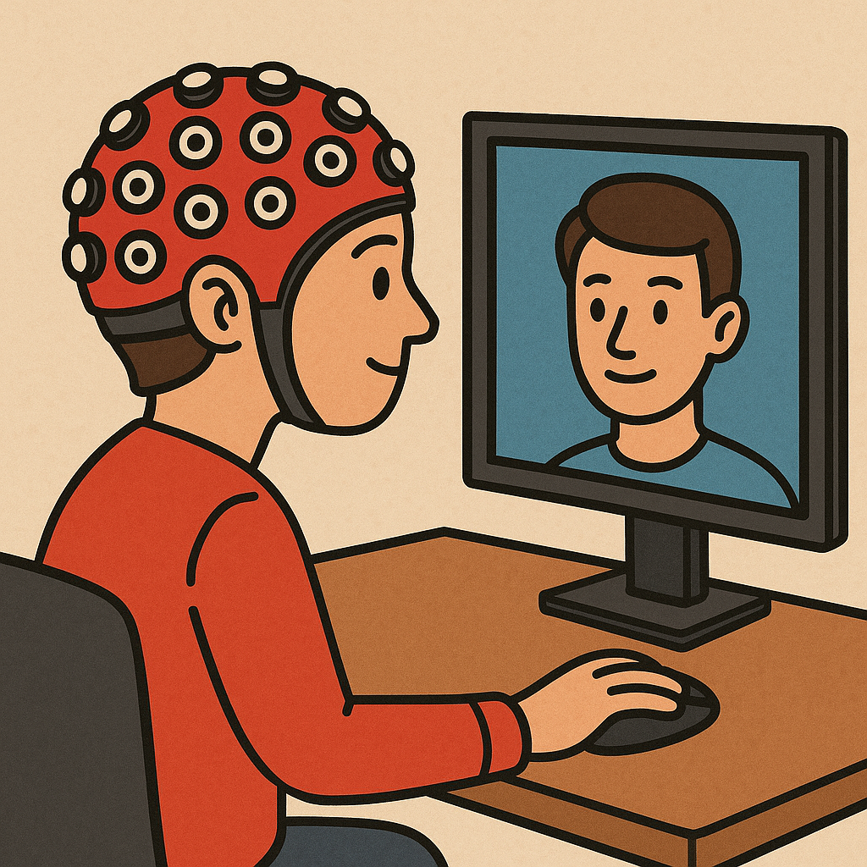





Neural mechanisms in processing of Emotion in Real and Virtual faces
Using Functional-near infrared spectroscopy (fNIRS)
By:
Dylan Rapanan
Co-supervised by:
Dr. Steven Livingstone Dr. Bobby Stojanoski
Notes:
Hello everyone, my name is Dylan Rapanan, and I am a Master's student in Computer Science at Ontario Tech University and I am co-supervised by Dr. Steven Livingstone and Dr. Bobby Stojanoski.
I’d like to thank everyone here for taking the time to attend my thesis defense.
Today, I will be presenting my research on the neural mechanisms involved in processing emotion in real and virtual faces using functional near-infrared spectroscopy (fNIRS).

Slide 2
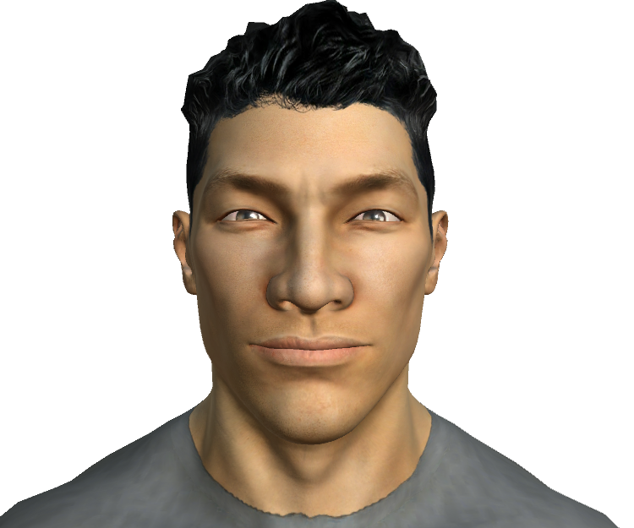
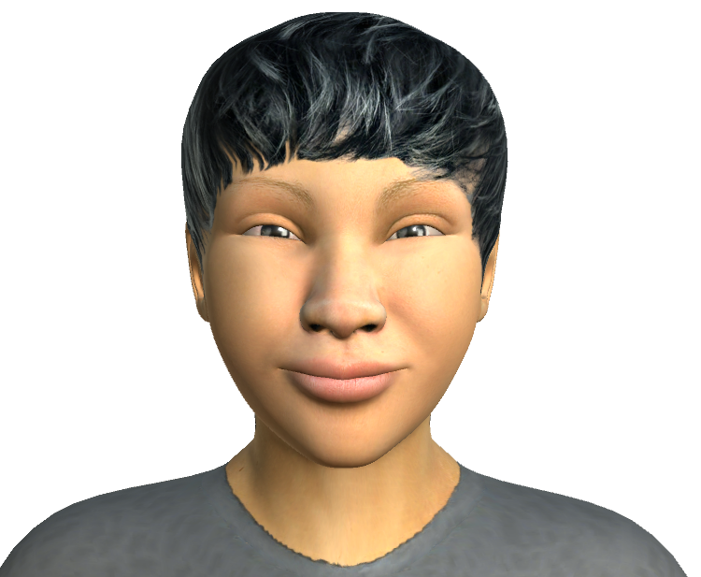
Intro: The Importance Of Faces And Emotional Expressions
Our brains are evolutionarily primed to process faces, as they are crucial for social interactions.
A central aspect of facial perception is emotional expressions, which underpins our interactions as social beings.
It is currently unclear how the brain processes emotional expressions, despite much research. [2]
Early models of facial perception proposed modular processing: face identity was linked to the fusiform face area (FFA) [2], while emotional expressions were associated with limbic structures like the amygdala. [4]
Notes:
Our brains are evolutionarily primed to process faces, as they are crucial for social interactions.
A central aspect of facial perception is emotional expressions, which underpins our interactions as social beings.
It is currently unclear how the brain processes emotional expressions, despite much research.
Early models of facial perception proposed that face identity was linked to the fusiform face area (FFA), while emotional expressions were associated with limbic structures like the amygdala.
This is the idea that there are specific locations or areas in the brain that are responsible for processing faces and emotions.

Slide 3
Intro: The Shift to Virtual Environments
As humans spend increasing time in digital and virtual environments, we interact more and more with computer-generated/avatar faces in our lives.
While real-face emotion processing has been studied extensively, the neural mechanisms for perceiving and responding to virtual faces remain poorly understood. [1]
Recent evidence suggests face and emotion processing recruit distributed brain networks rather than isolated “face areas”, pointing to a need for network-level investigation. [3]
Notes:
So contrast the faces we just saw with these virtual faces here, do you think the brain processes these faces in the exact same way as real faces?
You see, as humans spend more time in digital and virtual environments, we interact more with computer-generated or avatar faces.
And while real-face emotion processing has been studied extensively, the neural mechanisms for perceiving and responding to virtual faces remain poorly understood.
As well, recent evidence suggests that face and emotion processing recruit distributed brain networks rather than isolated “face areas,” which points to a need for network-level investigation.
This means that instead of just one area of the brain being responsible for processing faces and emotions, there are multiple areas that work together to do this.
So let's lay out what exactly we want to find out in this study.

Slide 4
Objective/ Hypotheses
Objective:
Identify distinct patterns of brain activity that represent processing of different emotions on real and virtual faces.
Hypotheses:
Differential activity between real and virtual faces.
Differential activity across different emotions (Anger, Disgust, Fear, Joy, Sadness, Surprise, Neutral).
Notes:
The objective of this research is to identify distinct patterns of brain activity that represent the processing of different emotions on real and virtual faces.
We have two hypotheses: first, we expect to see differences in brain activity between real and virtual faces, and second, we expect to see differences in brain activity across different emotions, such as anger, disgust, fear, happiness, sadness, surprise, and neutral.
These are the 7 basic emotions that we are looking at in this study.

Slide 5
Participants
Participants were recruited from the Ontario Tech University SONA system.
87 participants completed the experiment, but only 52 participants were included after excluding those with poor data quality.
We used thresholds common in fNIRS research such as the Scalp Coupling Index (SCI).
The 52 participants ranged in age from 17-51 years old, with a mean age of 22 years, and 39/52 were female.
Notes:
Participants were recruited from the Ontario Tech University SONA system and were compensated with course credit for their participation.
A total number of 87 participants completed the experiment, but only 52 participants were included in the fNIRS analysis after excluding those with poor data quality.
We used thresholds common in fNIRS research such as the Scalp Coupling Index (SCI) to determine the quality of the data.
In terms of demographics, the 52 participants ranged in age from 17-51 years old, with a mean age of 22 years, and 39 out of 52 were female.

Slide 6
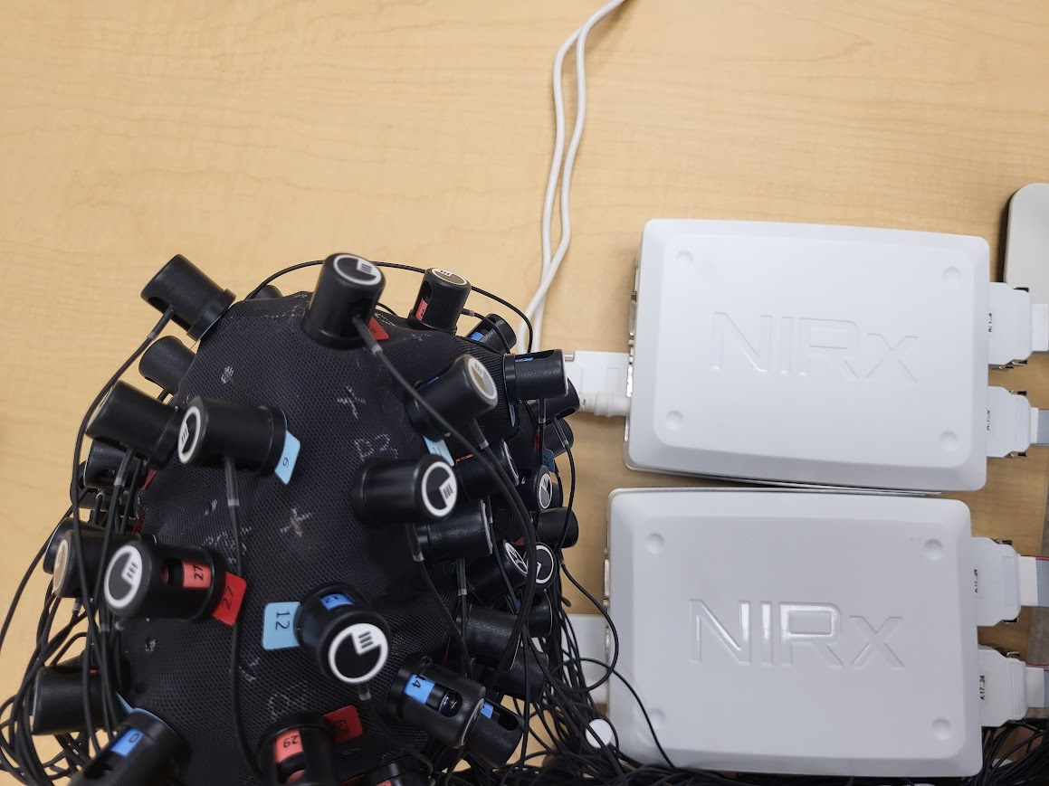
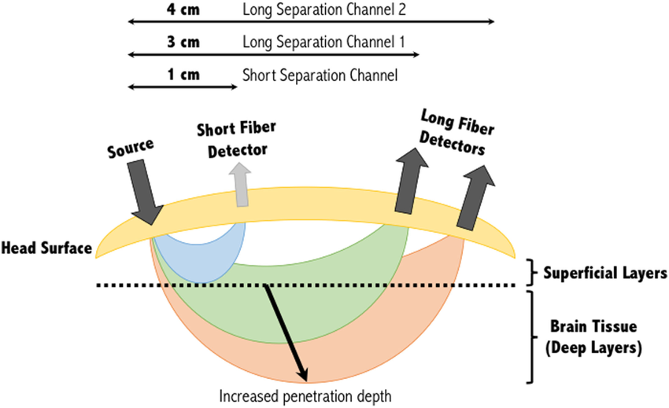
Functional near-infrared spectroscopy (fNIRS)
Functional near-infrared spectroscopy (fNIRS) is a non-invasive tool that tracks changes in blood oxygen levels in the brain as an indirect measure of neural activity.
Notes:
In order to quantify differences in brain activity, we need a tool called functional near-infrared spectroscopy (fNIRS).
So what is fNIRS? fNIRS is a non-invasive tool that tracks changes in blood oxygen levels in the brain as an indirect measure of neural activity.
How does fNIRS work? It works by shining near-infrared light into the scalp and measuring how much light is absorbed and scattered by brain tissue.
There are tiny light sources called emitters and light sensors called detectors that are placed on the scalp, the emitters send light into the head, and the detectors record the back-scattered light that emerges.
fNIRS estimates shifts in blood oxygenation, which provides insights into which brain areas are active.

Slide 7
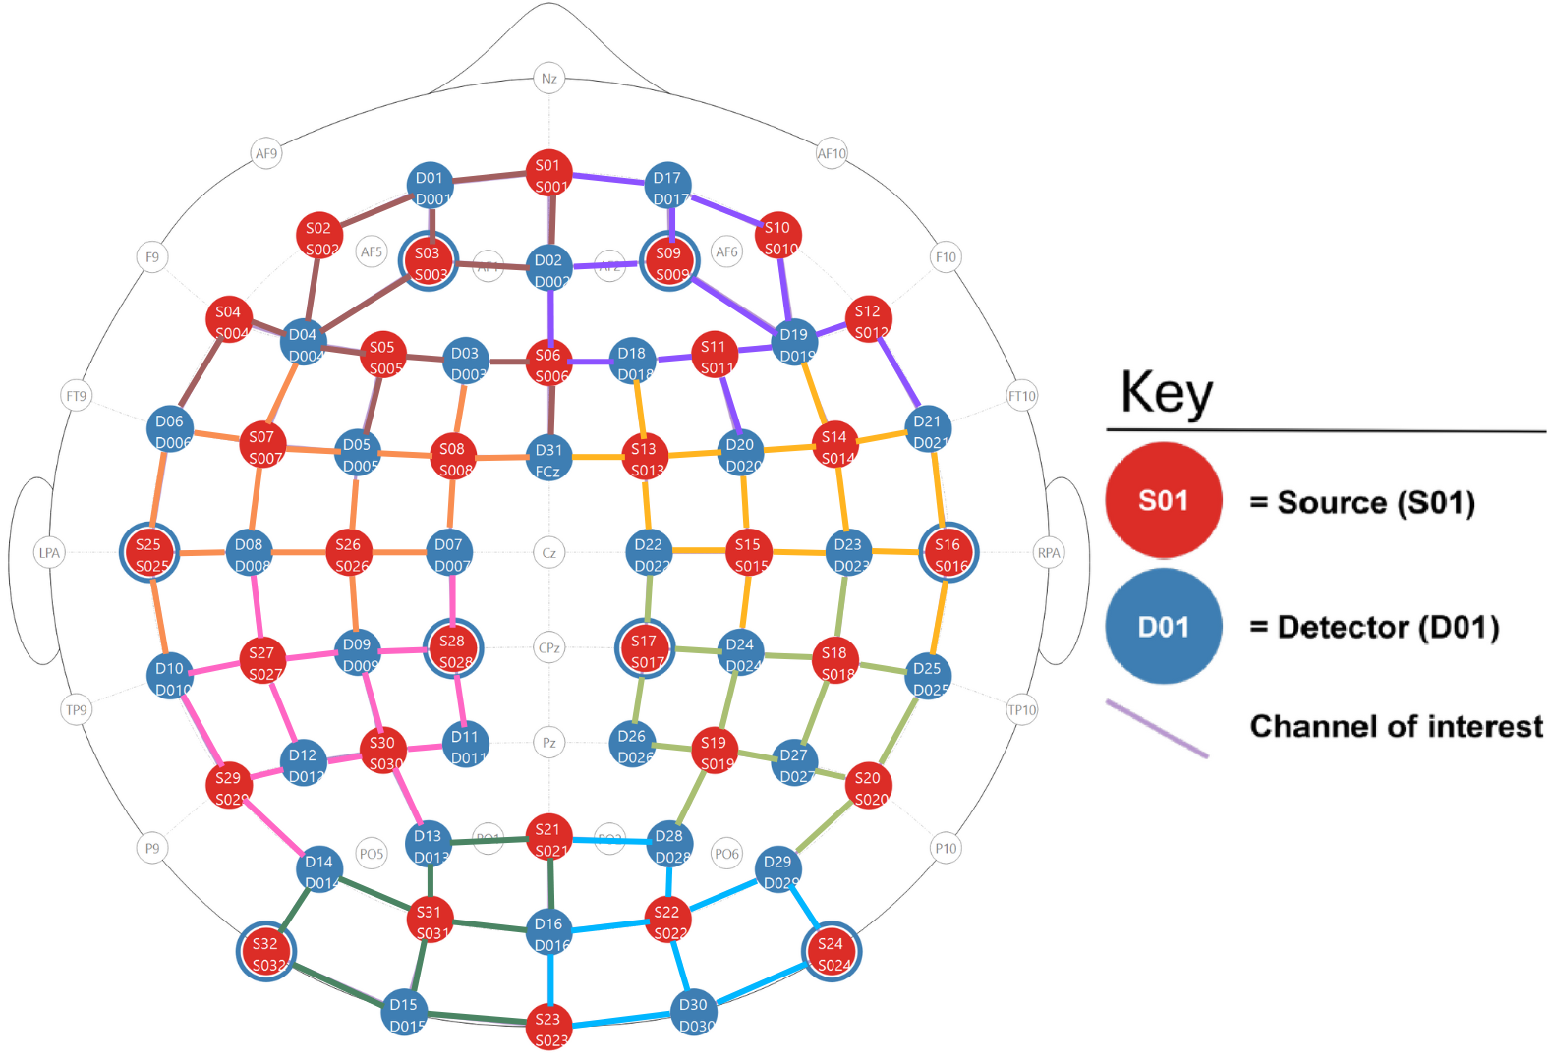
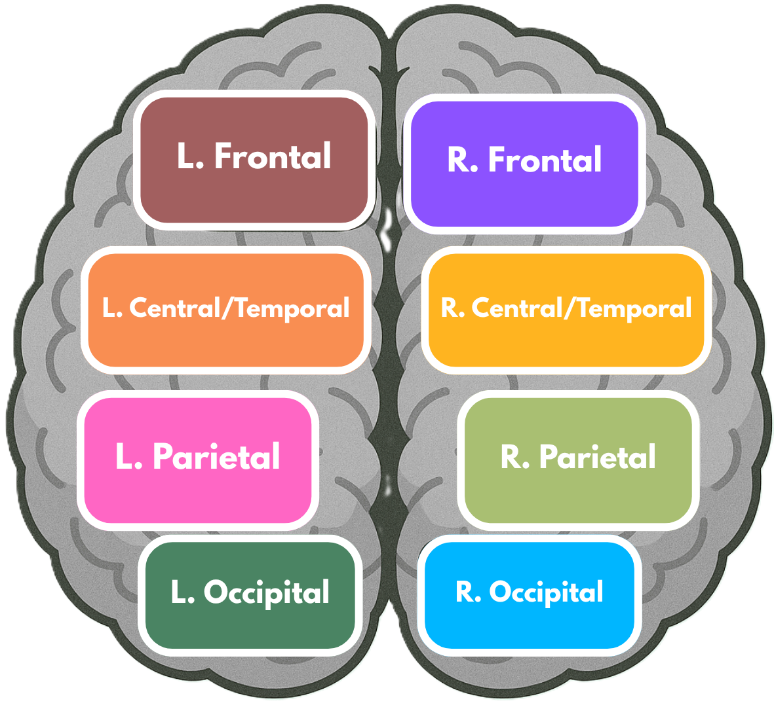
fNIRS Data Acquisition
Montage of fNIRS cap, which shows the placement of the optodes on the scalp.
Each neighboring pair of source (red) and detector (blue) optode is referred to as a channel (colored line), resulting in 103 channels.
The color of the channels correspond to the brain region.
Notes:
So here is the montage of fNIRS cap, which shows the placement of the optodes on the scalp.
Each neighboring pair of source (red) and detector (blue) optode is referred to as a channel, which are the colored lines connecting them, this results in 103 channels in total.
If you look closely at the top plot, the color of the channels correspond to the brain regions in the bottom plot.
We aimed to cover a maximal area of the brain with this montage, as facial and emotional processing is distributed across the cortex.

Slide 8
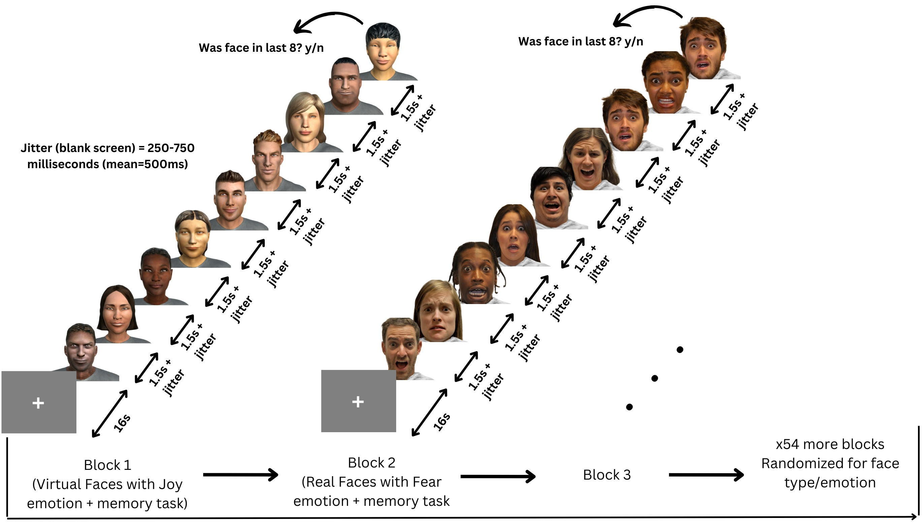
Design and Procedure
Participants viewed 56 blocks of 8 faces, each block being either all real or all virtual faces.
Every face in a block displayed the same emotional expression, one of: Anger, Disgust, Fear, Joy, Sadness, Surprise, Neutral.
Memory task: Participants had to indicate whether the 9th face was present in the previous 8 faces by answering "yes" or "no".
Notes:
So here was the experiment: participants viewed 56 blocks of faces, with each block containing 8 faces of the same emotion (e.g., joy, fear) and type (real or virtual).
The faces were shown one at a time for 1.5 seconds each, with short random jitters of about half a second between them.
After the 8 faces were shown, participants had to indicate whether the 9th face was present in the previous 8 faces by answering "yes" or "no" within 7 seconds, this was the memory task they had to do for the main purpose of keeping them engaged and focused on the faces.
As for the actual faces that were shown, we selected 20 models, 10 from the RADIATE dataset of real people and 10 from the UIBVFED dataset of virtual characters, ensuring a balanced mix of gender and ethnic diversity.
Each model was carefully matched across datasets by facial features, and emotional expression.

Slide 9
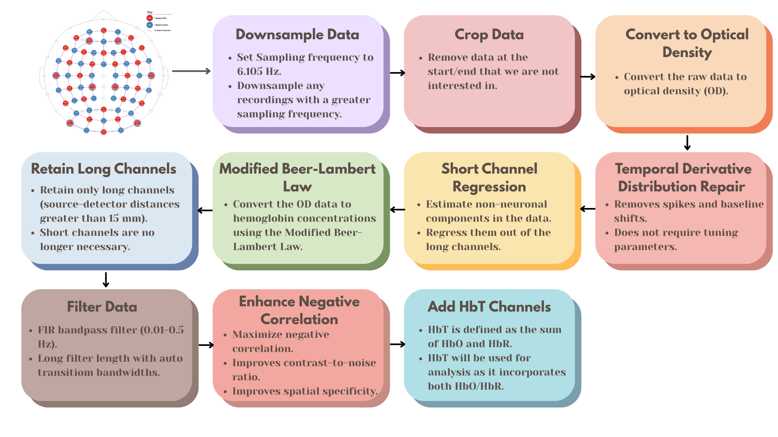
fNIRS Preprocessing
Prepare raw fNIRS data for analysis by removing noise, artifacts, and irrelevant information.
This ensures the data is suitable for extracting meaningful insights about brain activity.
Notes:
Before we can analyze the data, we have to preprocess it.
This is done through a series of steps, including converting to optical density (OD), applying motion and artifact correction algorithms, converting to hemoglobin concentrations using the modified Beer-Lambert law, and filtering the data.
This ensures that the data we are analyzing is suitable for extracting meaningful insights about brain activity.
The three types of data we get from fNIRS are Oxygenated Hemoglobin, or HbO, Deoxygenated Hemoglobin, or HbR, and Total Hemoglobin, or HbT, which is the sum of HbO and HbR.
We will be using HbT for our analyses, as it utilizes the information from both HbO and HbR.

Slide 10
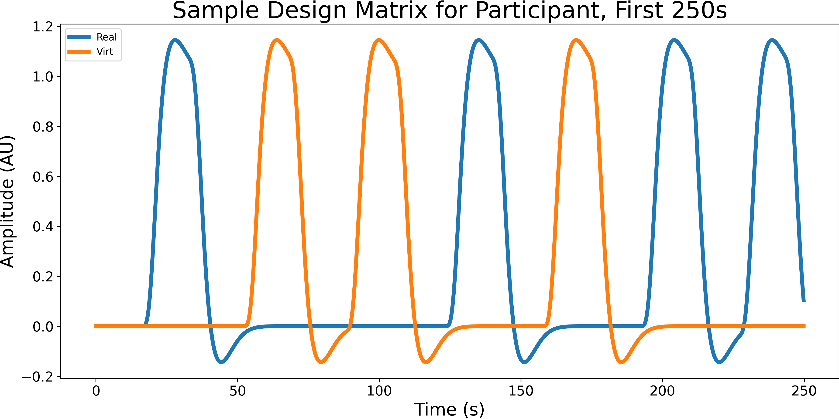
Analysis 1: General Linear Model (GLM)
Create a design matrix where each column represents one type of event/condition.
For each stimulus column, you mark onset/offset times and then “stretch” those into the shape of a typical blood-flow response.
This gives you a set of predicted response patterns for each condition, that you'll try to match to your actual fNIRS recordings.
We then find a set of β values (using OLS), that tell you how big the brain's blood-flow response was for each event type.
A higher β-weight means a stronger activation associated with that stimulus in that channel.
Notes:
So fNIRS data is extremely rich and complex, and there are many ways to analyze it, but we will be focusing on two common analyses, the first being the General Linear Model (GLM).
The GLM is a tool that helps us understand how different conditions or events affect brain activity.
To do this, we create a design matrix where each column represents one type of event or condition, such as real faces or virtual faces.
For each stimulus column, we mark the onset/offset times of the event and then stretch those into the shape of a typical blood-flow response.
This is the start/end of blocks of faces that the participants saw.
This gives us a set of predicted response patterns for each condition, that we will try to match to our actual fNIRS recordings.
We then find a set of β values (using Ordinary Least Squares), that tell us how big the brain's blood-flow response was for each event type.
Higher β weights means stronger activation in that channel associated with that stimulus.

Slide 11
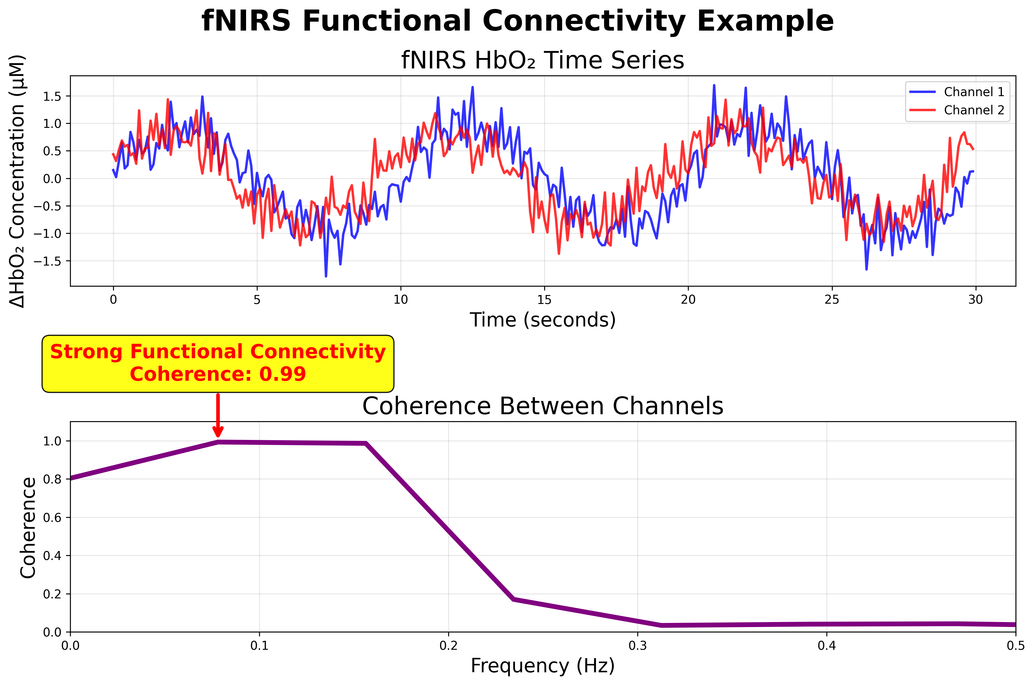
Analysis 2: Functional Connectivity
Functional connectivity describes how blood-flow signals from different brain regions fluctuate together over time, showing which areas of the brain are working in sync.
We apply a continuous wavelet transform (CWT) using a Morlet wavelet focused on the 0.2-0.5 Hz range.
The CWT gives us coherence scores (ranging from 0 to 1) for frequencies within that range.
We can see which brain areas synchronize their activity under different conditions.
Notes:
The second analysis we will be looking at is functional connectivity (FC).
Functional connectivity is like figuring out which parts of the brain are "in sync" or working together by looking at how their activity changes over time.
To do this, we use a tool called continuous wavelet transform (CWT), which helps us zoom in on specific brain activity patterns in a certain range (0.2-0.5 Hz).
The CWT gives us scores between 0 and 1, where 1 means two brain areas are perfectly synchronized, and 0 means they are not at all synchronized.
So we can see which brain areas are most connected and how this changes depending on the condition (e.g., real vs. virtual faces).

Slide 12
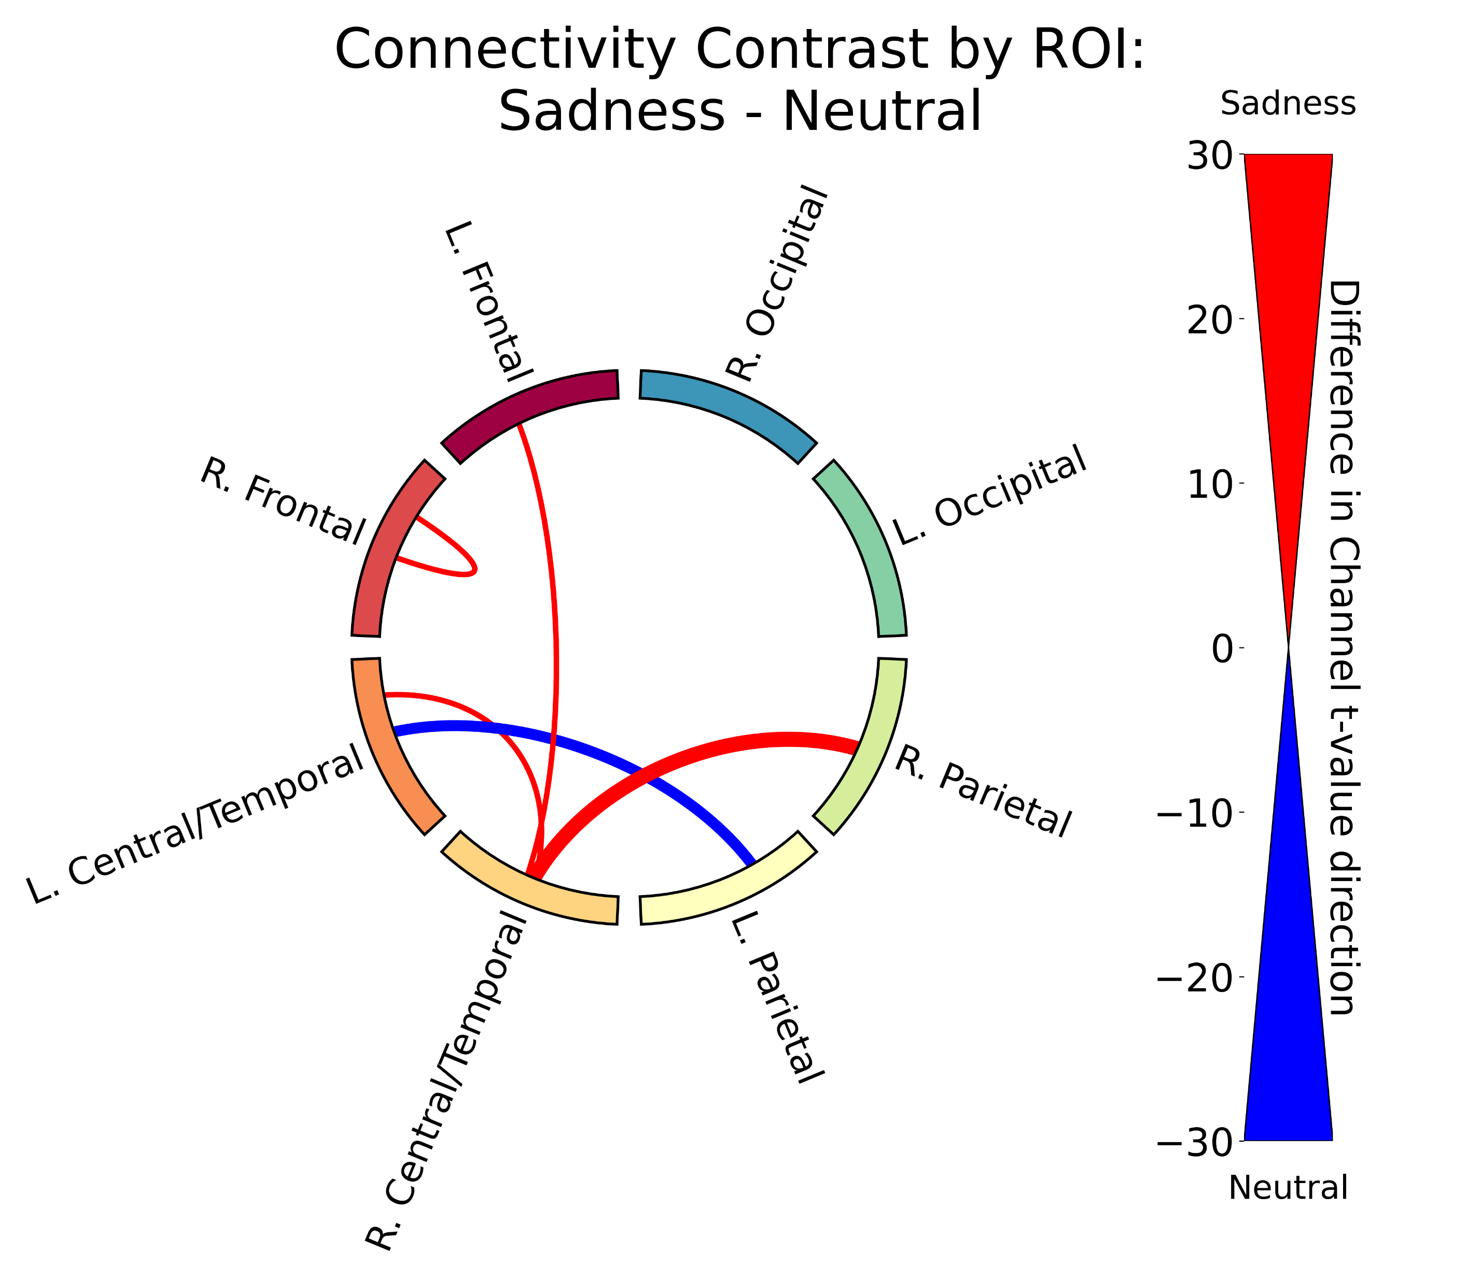
Analysis 2: Functional Connectivity
Coherence scores were grouped into defined brain regions.
We counted the number of significantly different channel pairs with positive or negative t-values (from a t-test), then subtracted the negative count from the positive to get a single net connectivity score for each pair of regions.
Only the top 15% of net connectivity scores were visualized in a chord diagram.
Line color indicates the direction (more positive or more negative connections)
Line width represents the strength (number of significant connections).
Notes:
After running the CWT, we grouped the coherence scores into defined brain regions.
We then counted the number of significantly different channel pairs with positive or negative t-values (from a t-test that we ran between conditions), then subtracted the negative count from the positive to get a single net connectivity score for each pair of regions.
Only the top 15% of net connectivity scores were visualized in a chord diagram like this one here, with line color indicating the direction.
So in this case, red means Sadness had stronger connectivity between those two regions.
Line width represents the number of significant connections between those two regions, essentially, the thicker the line, the stronger the difference in connectivity.

Slide 13
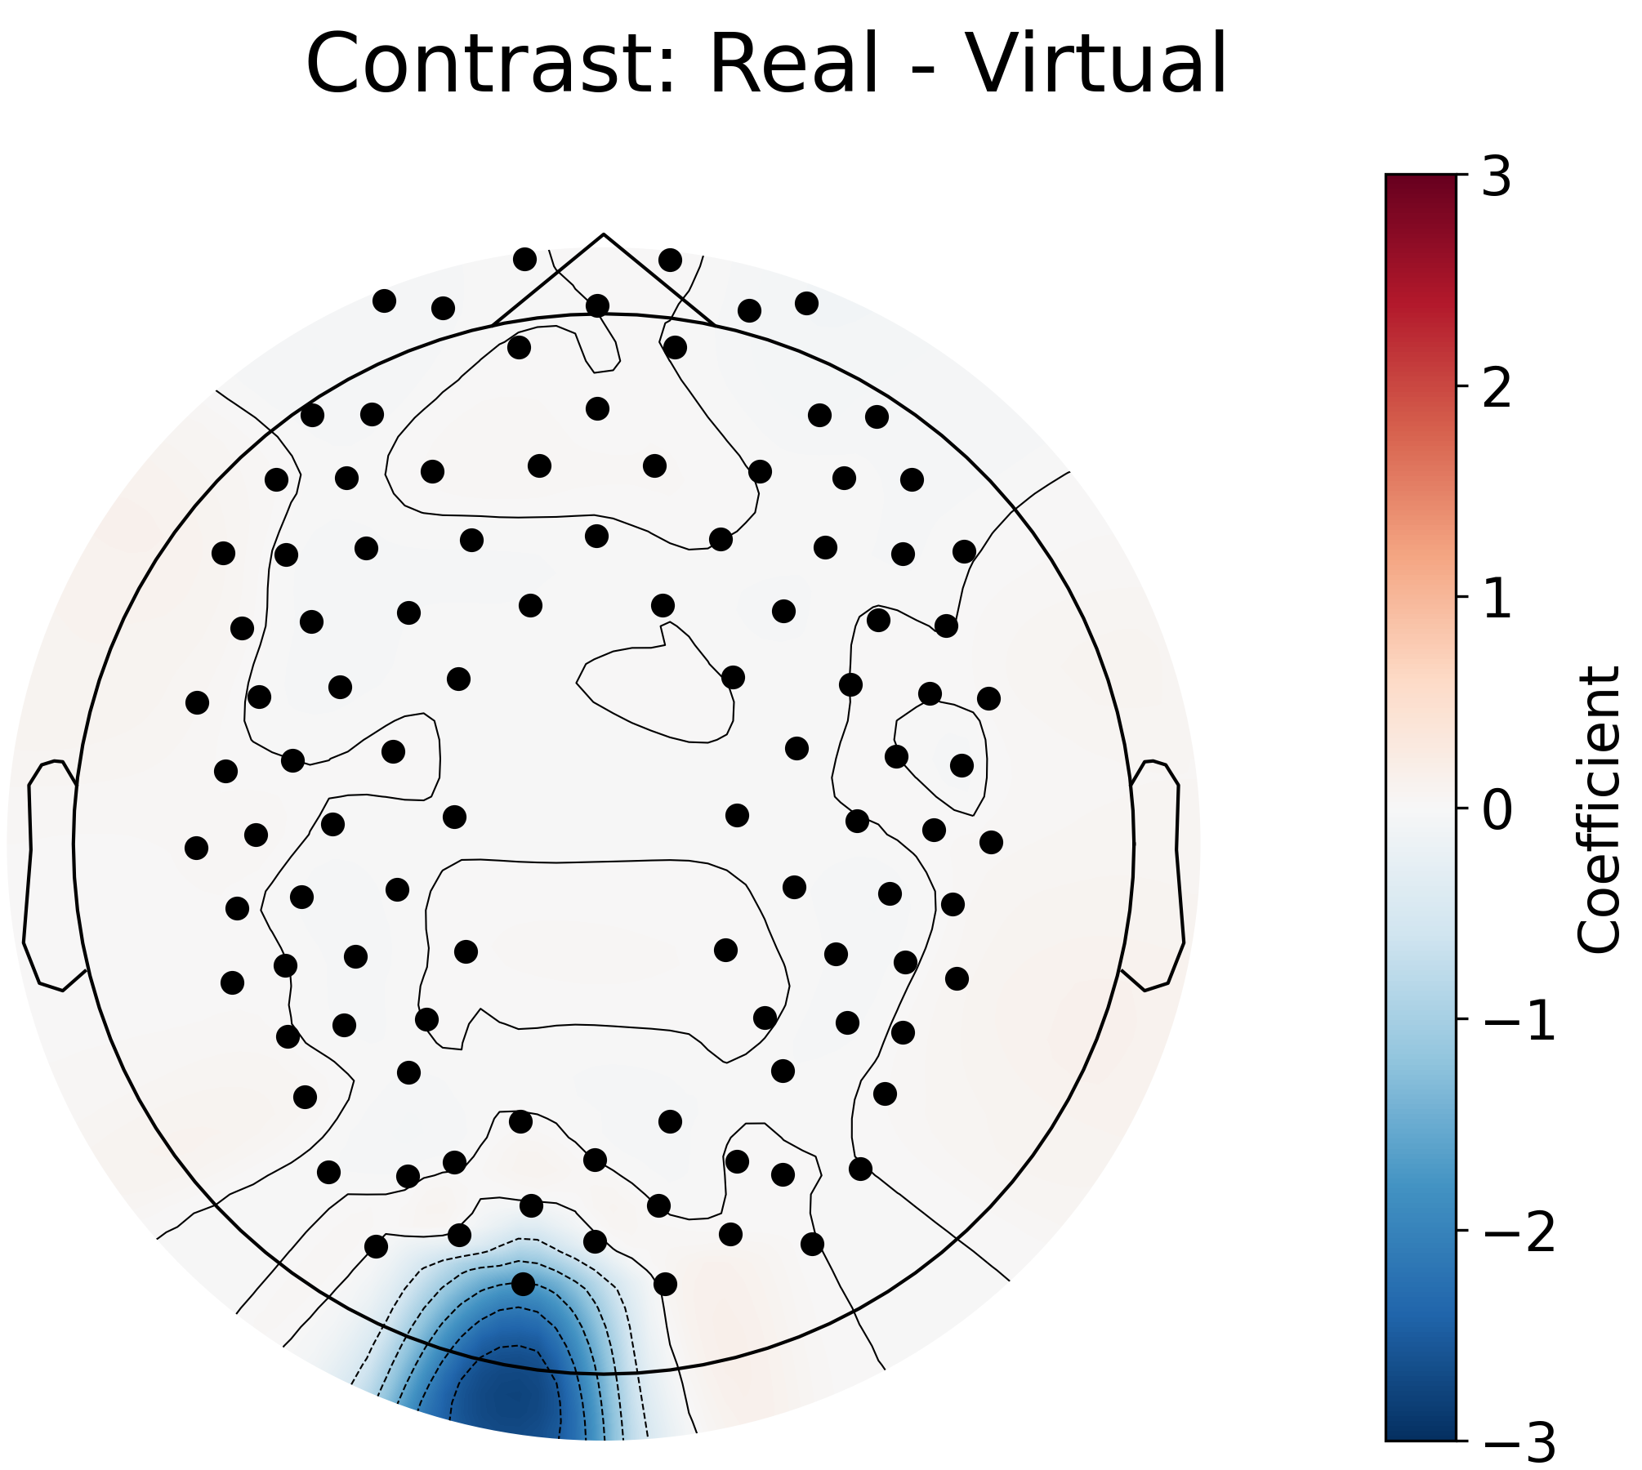
Results: Real Vs. Virtual Faces
GLM contrast between real and virtual conditions showing the differences in activation.
Blue signifies that condition 2 (virtual faces) has more activation than condition 1 (real faces).
Left occipital region has slightly more activation for virtual Faces.
Notes:
So finally, it's time to look at the results of our analyses for real vs. virtual faces.
Here we have the GLM contrast for real vs. virtual faces, which shows the differences in activation between the two conditions.
The way to read this is that if the color is blue, it means that virtual faces have more activation than real faces, and vice versa.
We see the left occipital region has one channel that has higher activation for virtual faces compared to real faces.

Slide 14
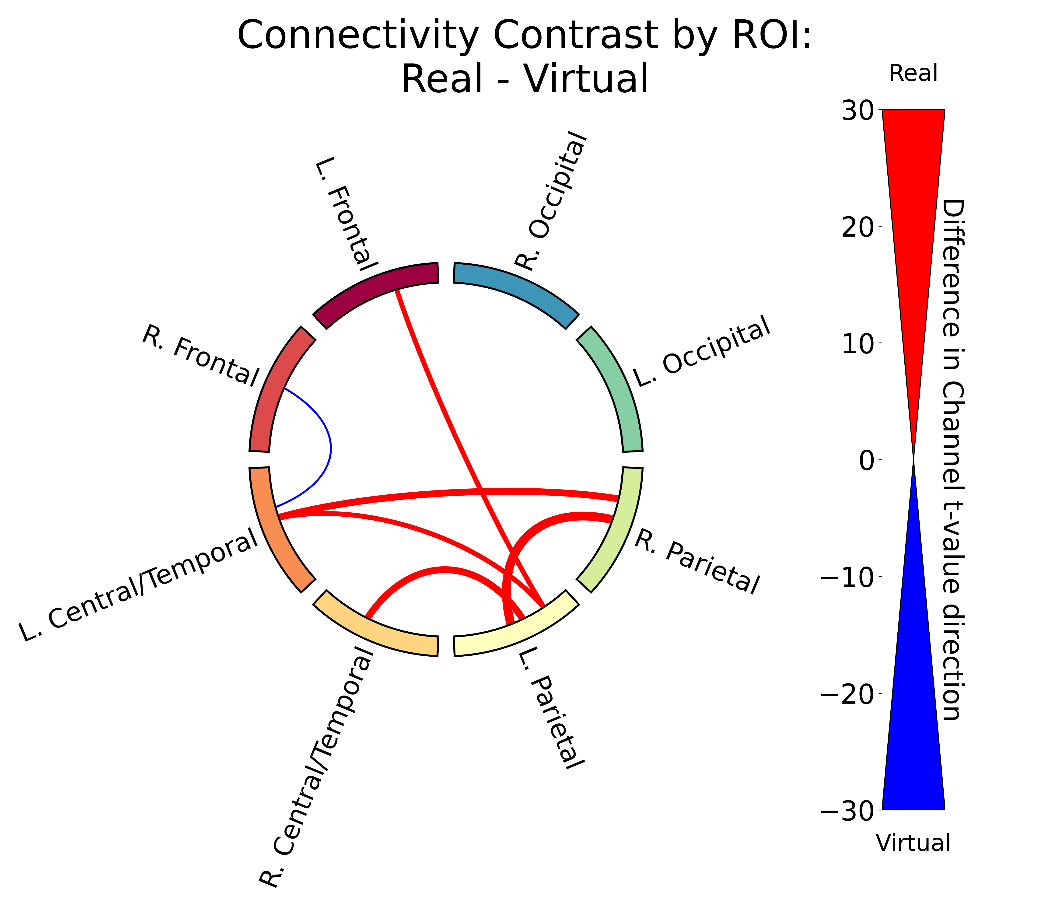
Results: Real Vs. Virtual Faces
Difference in connectivity for real and virtual faces.
We see stronger connectivity between parietal, central/temporal, and left frontal regions for processing real faces.
Notes:
Here we have the differences in connectivity for real vs. virtual faces.
We see stronger connectivity between parietal, central/temporal, and left frontal regions for processing real faces.

Slide 15
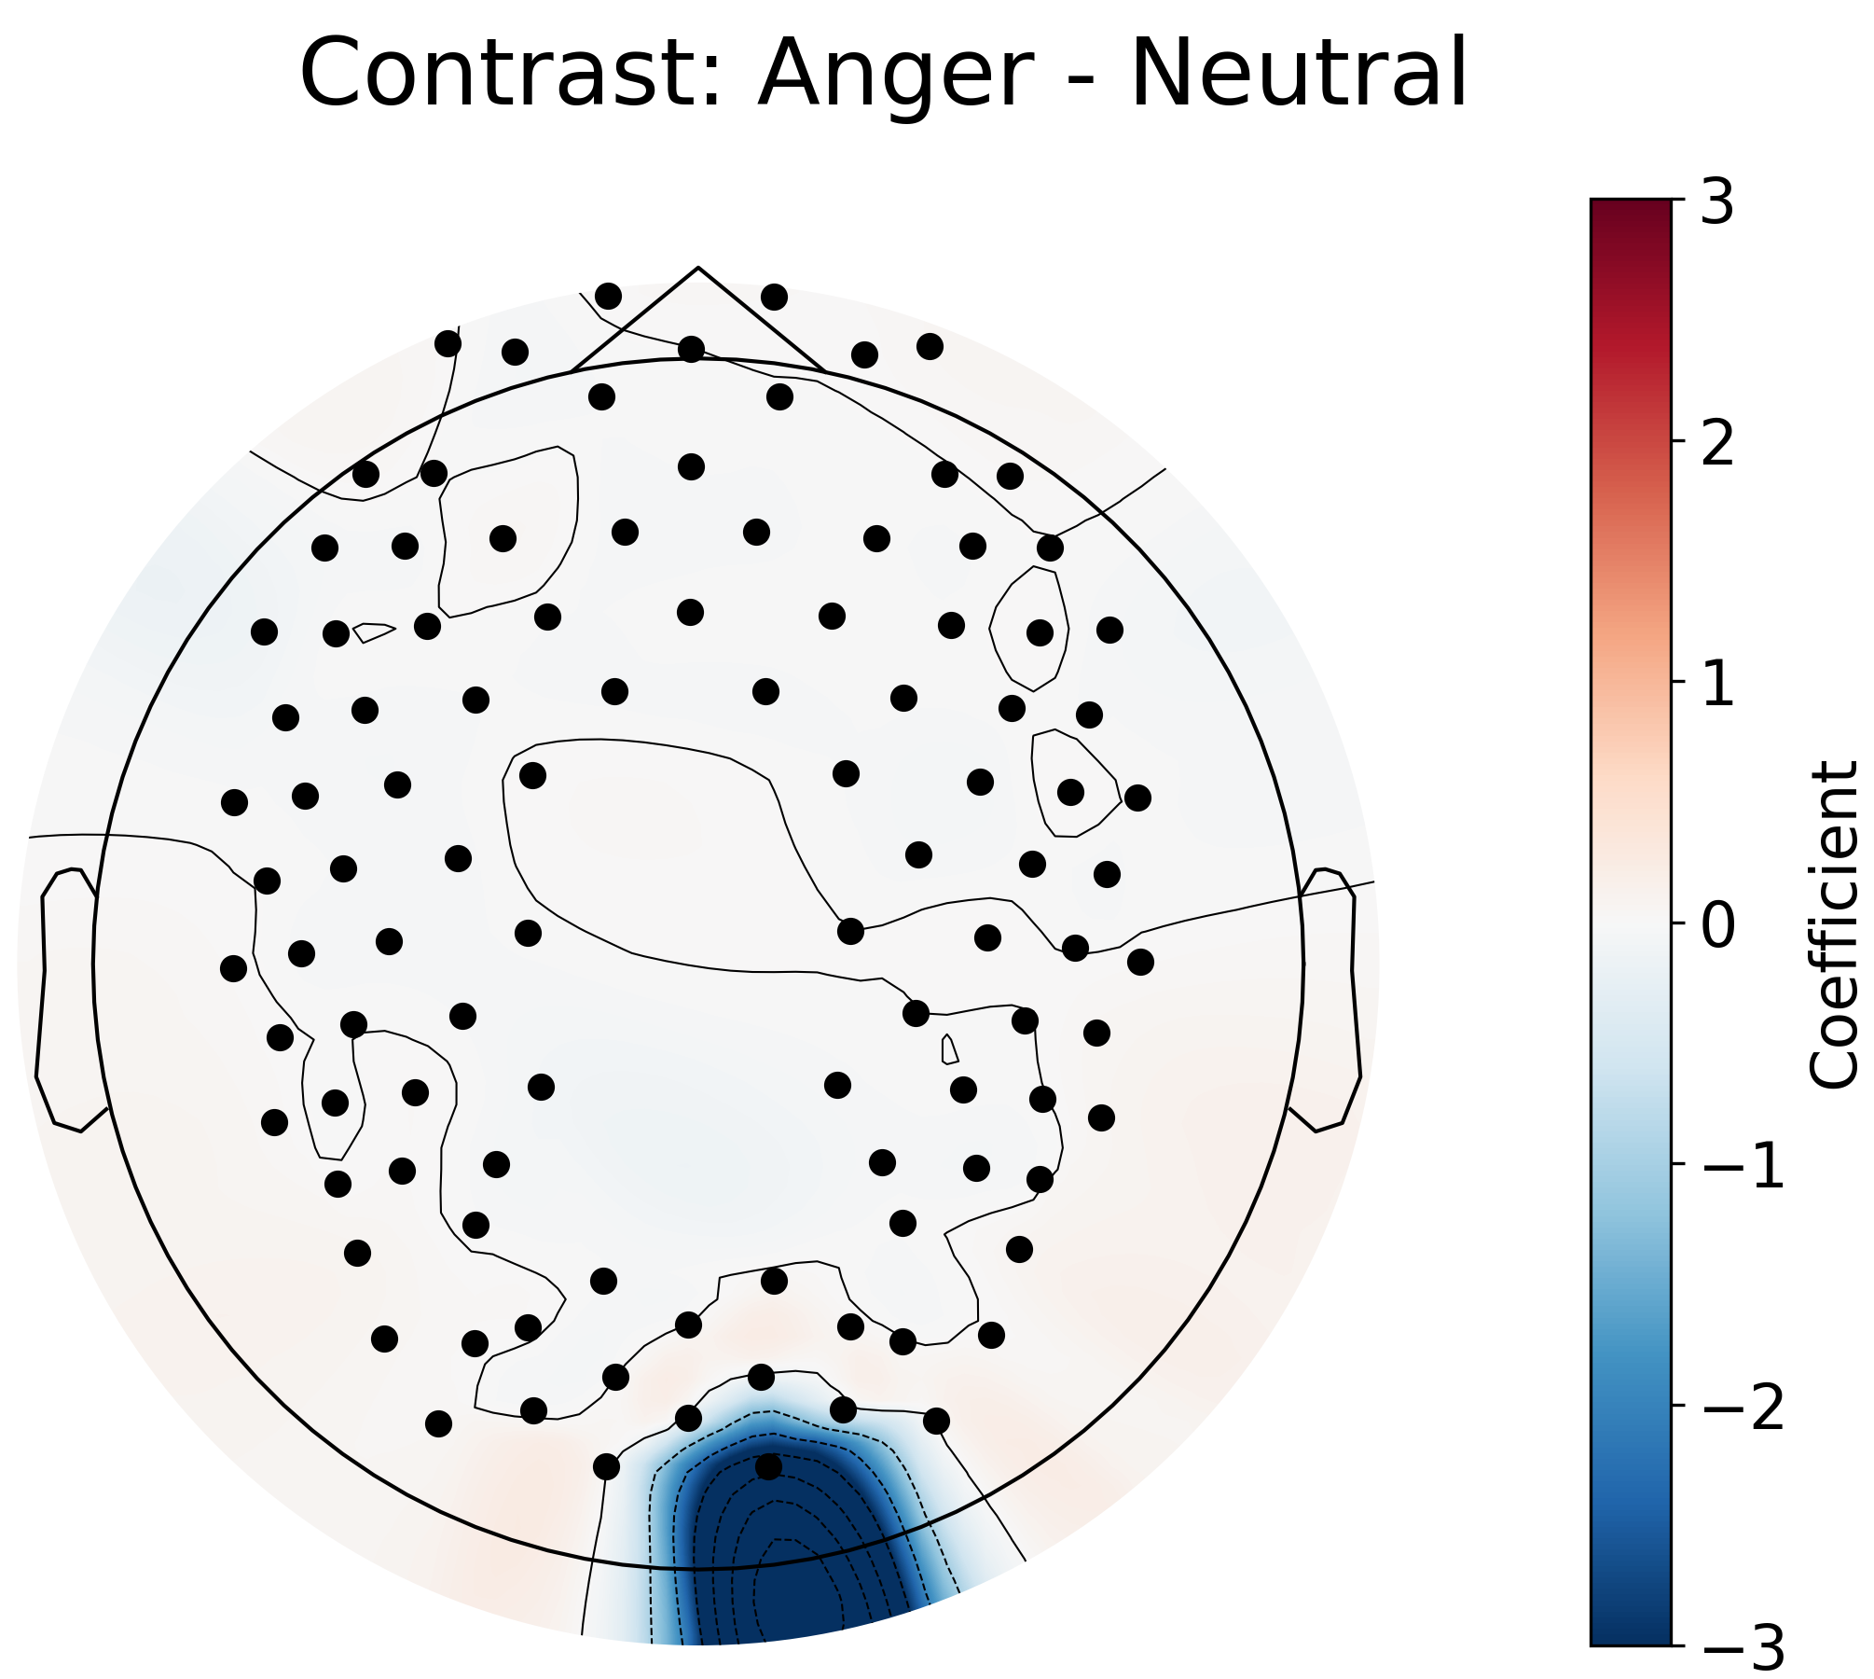
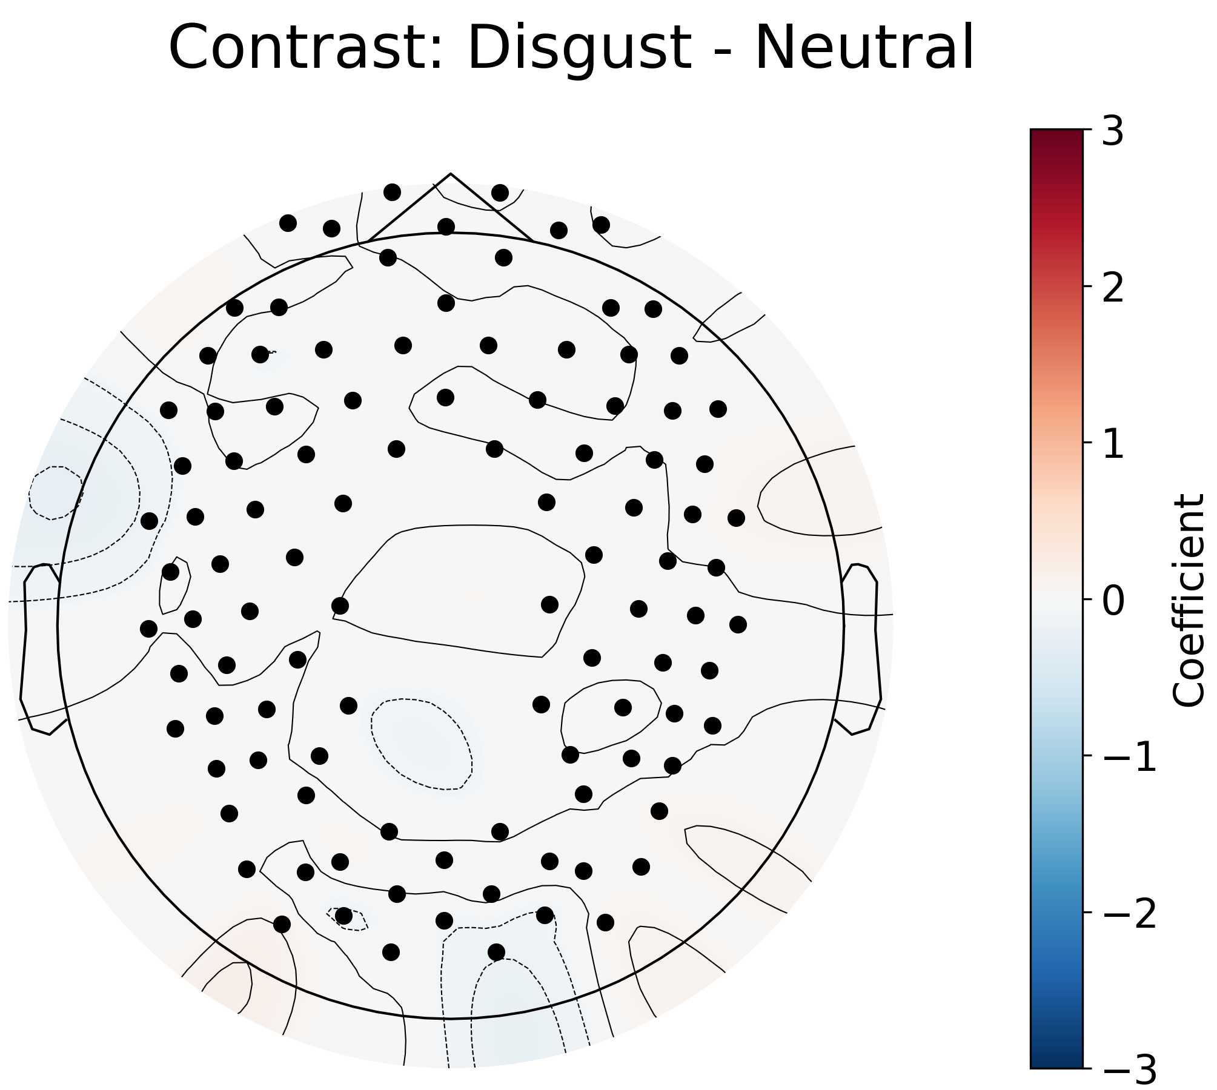
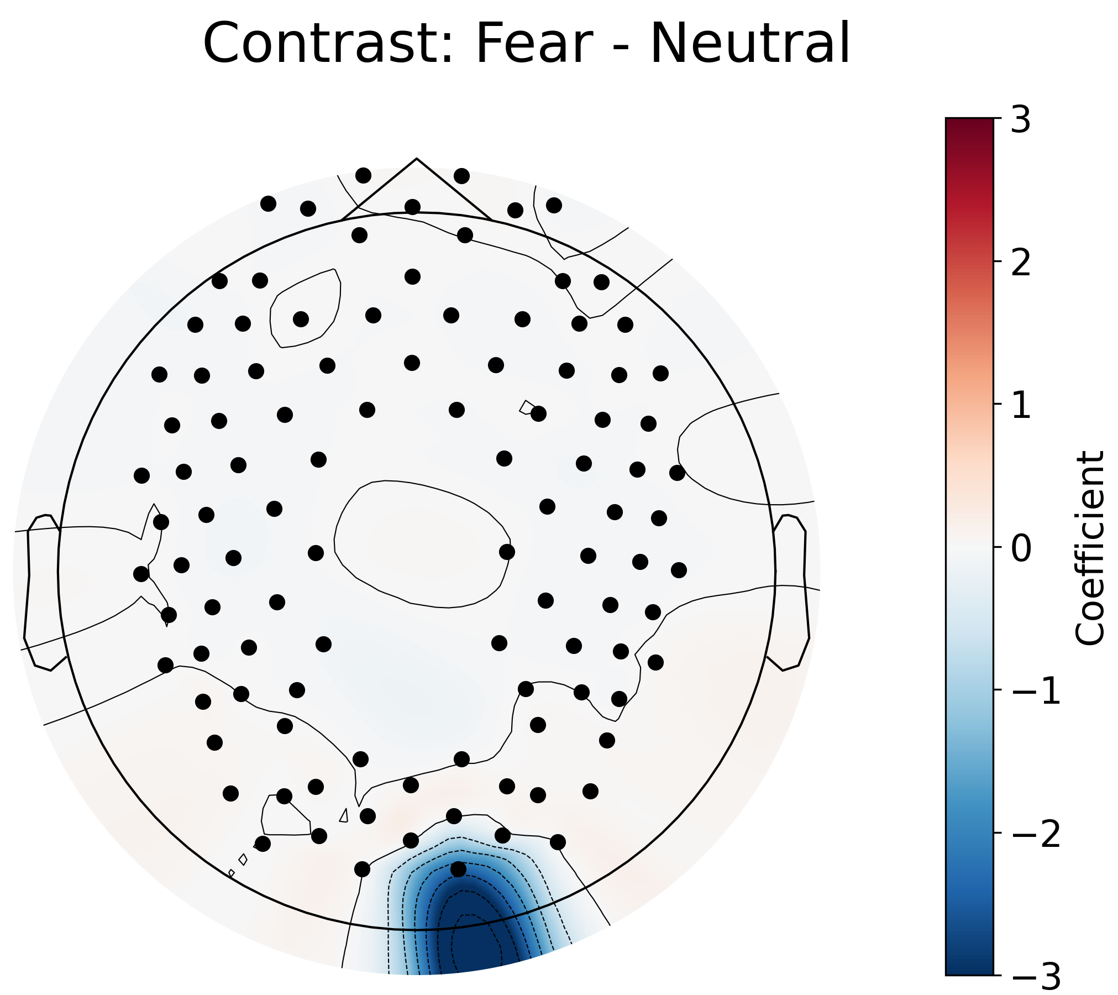
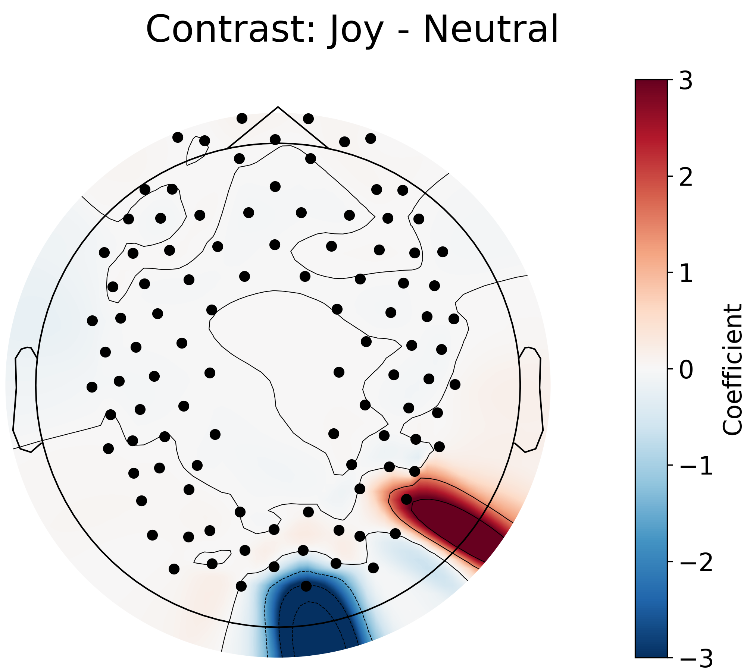
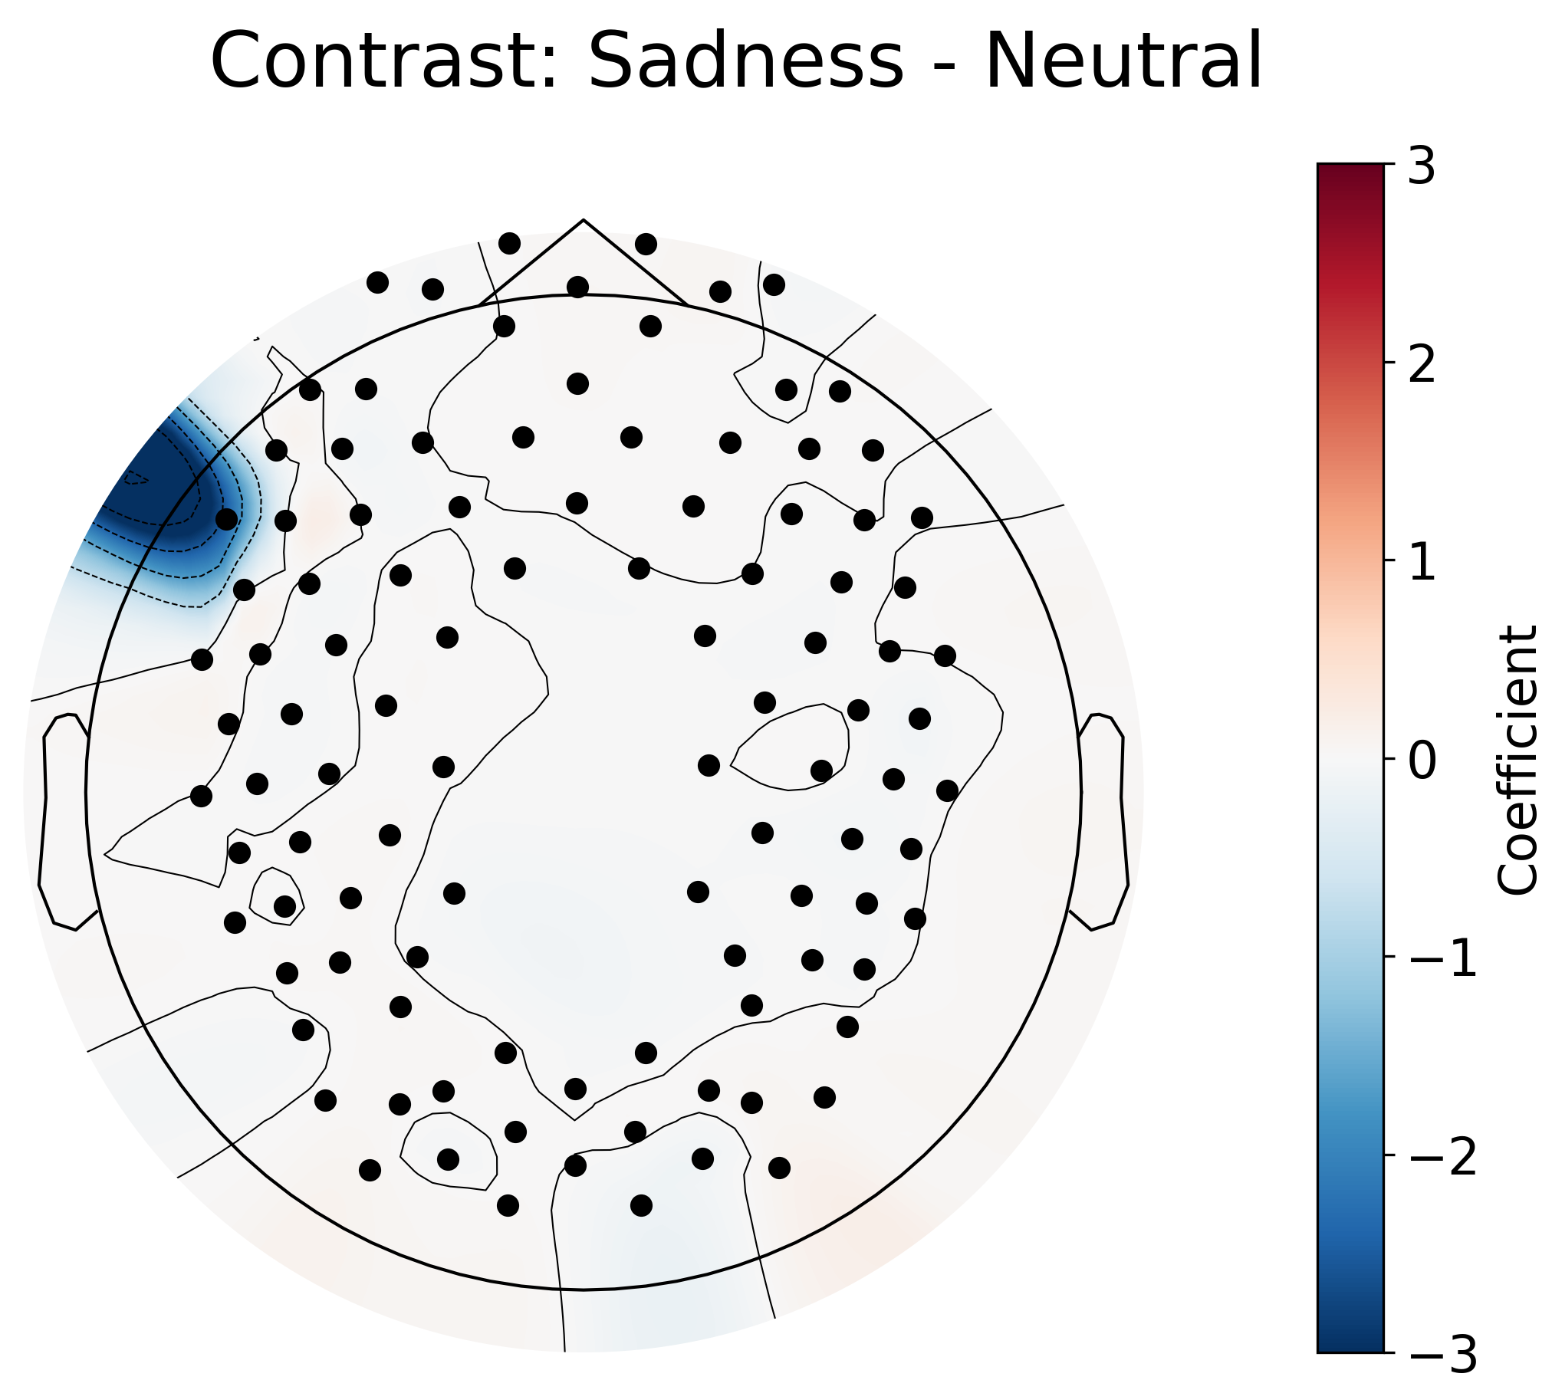
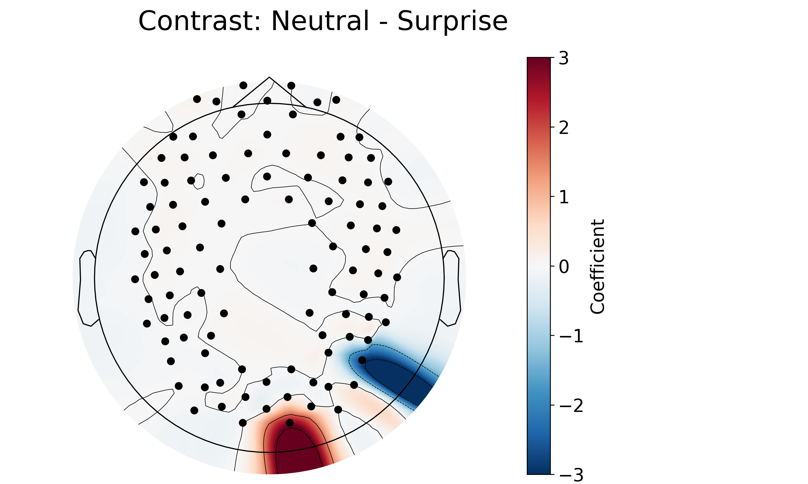
Results: Emotional Faces Neutral Vs. All Other Emotions
The GLM contrast for Neutral vs. all other emotions shows differences in activation in multiple regions. (except Disgust)
Notes:
Now, on to the results for the emotional faces.
The emotion Neutral shows significant differences in activation from all of the other emotions in multiple regions, except for disgust.

Slide 16
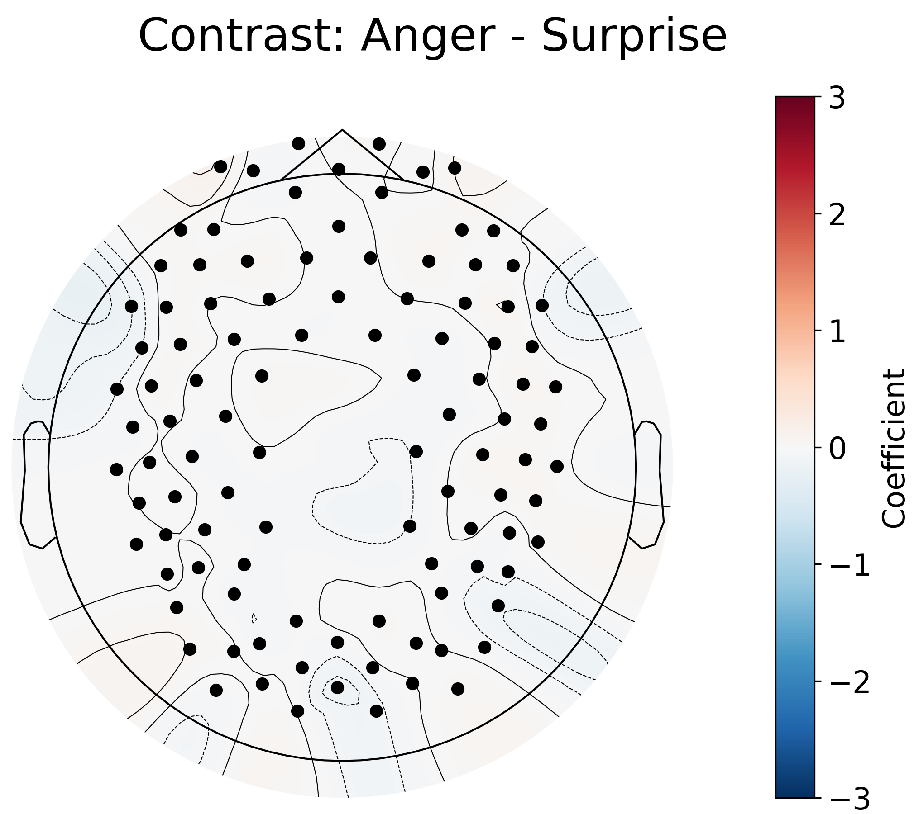
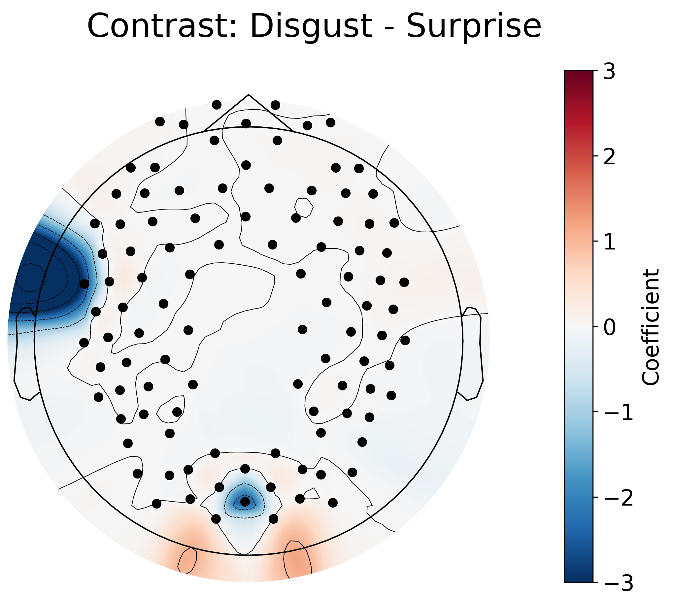
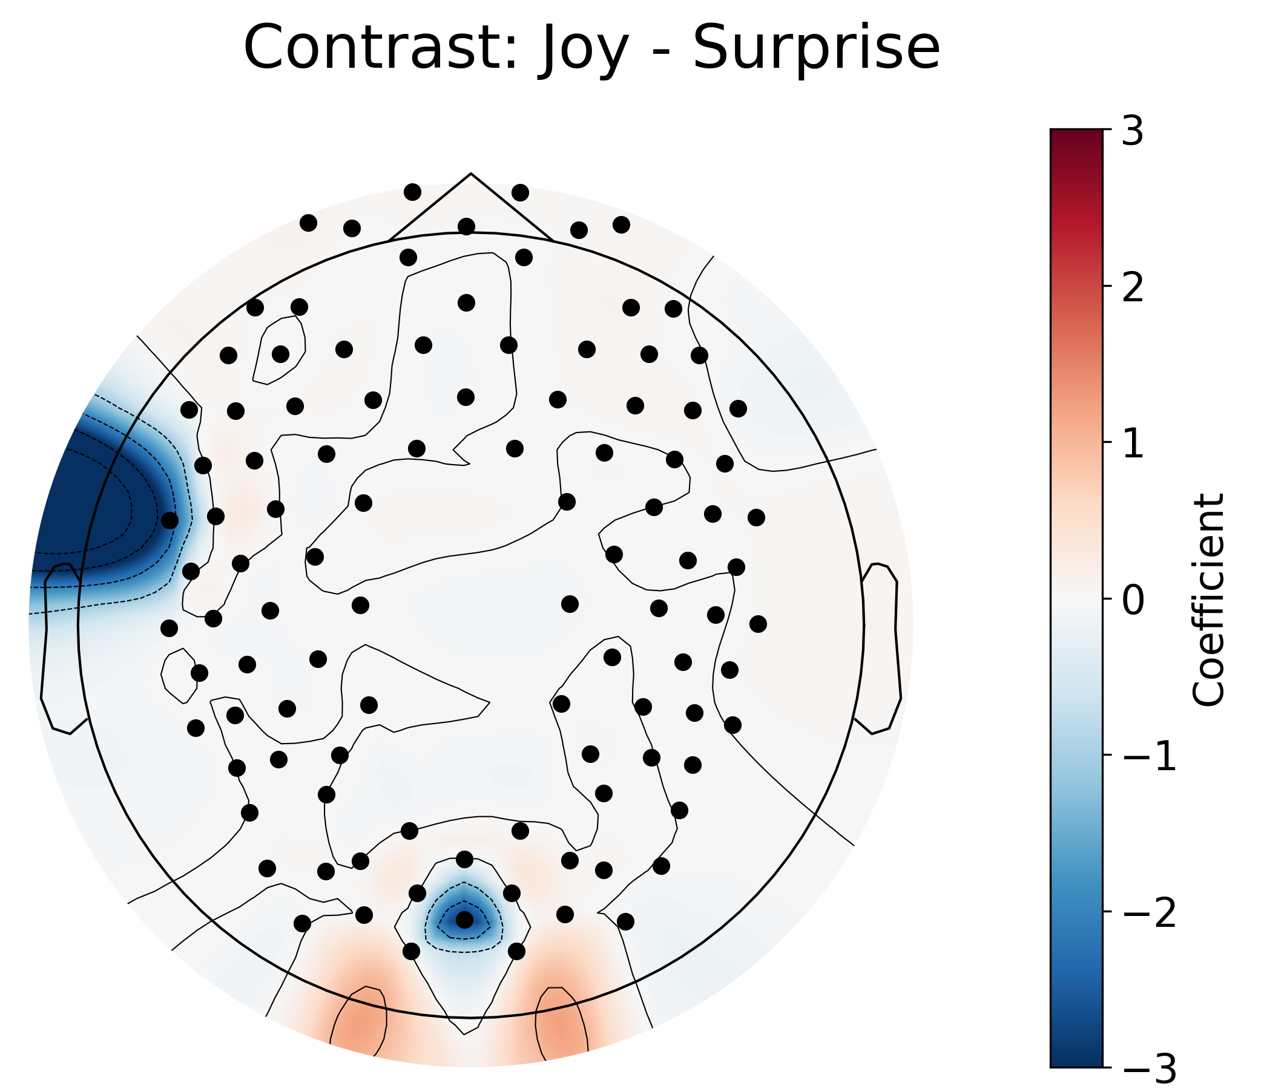
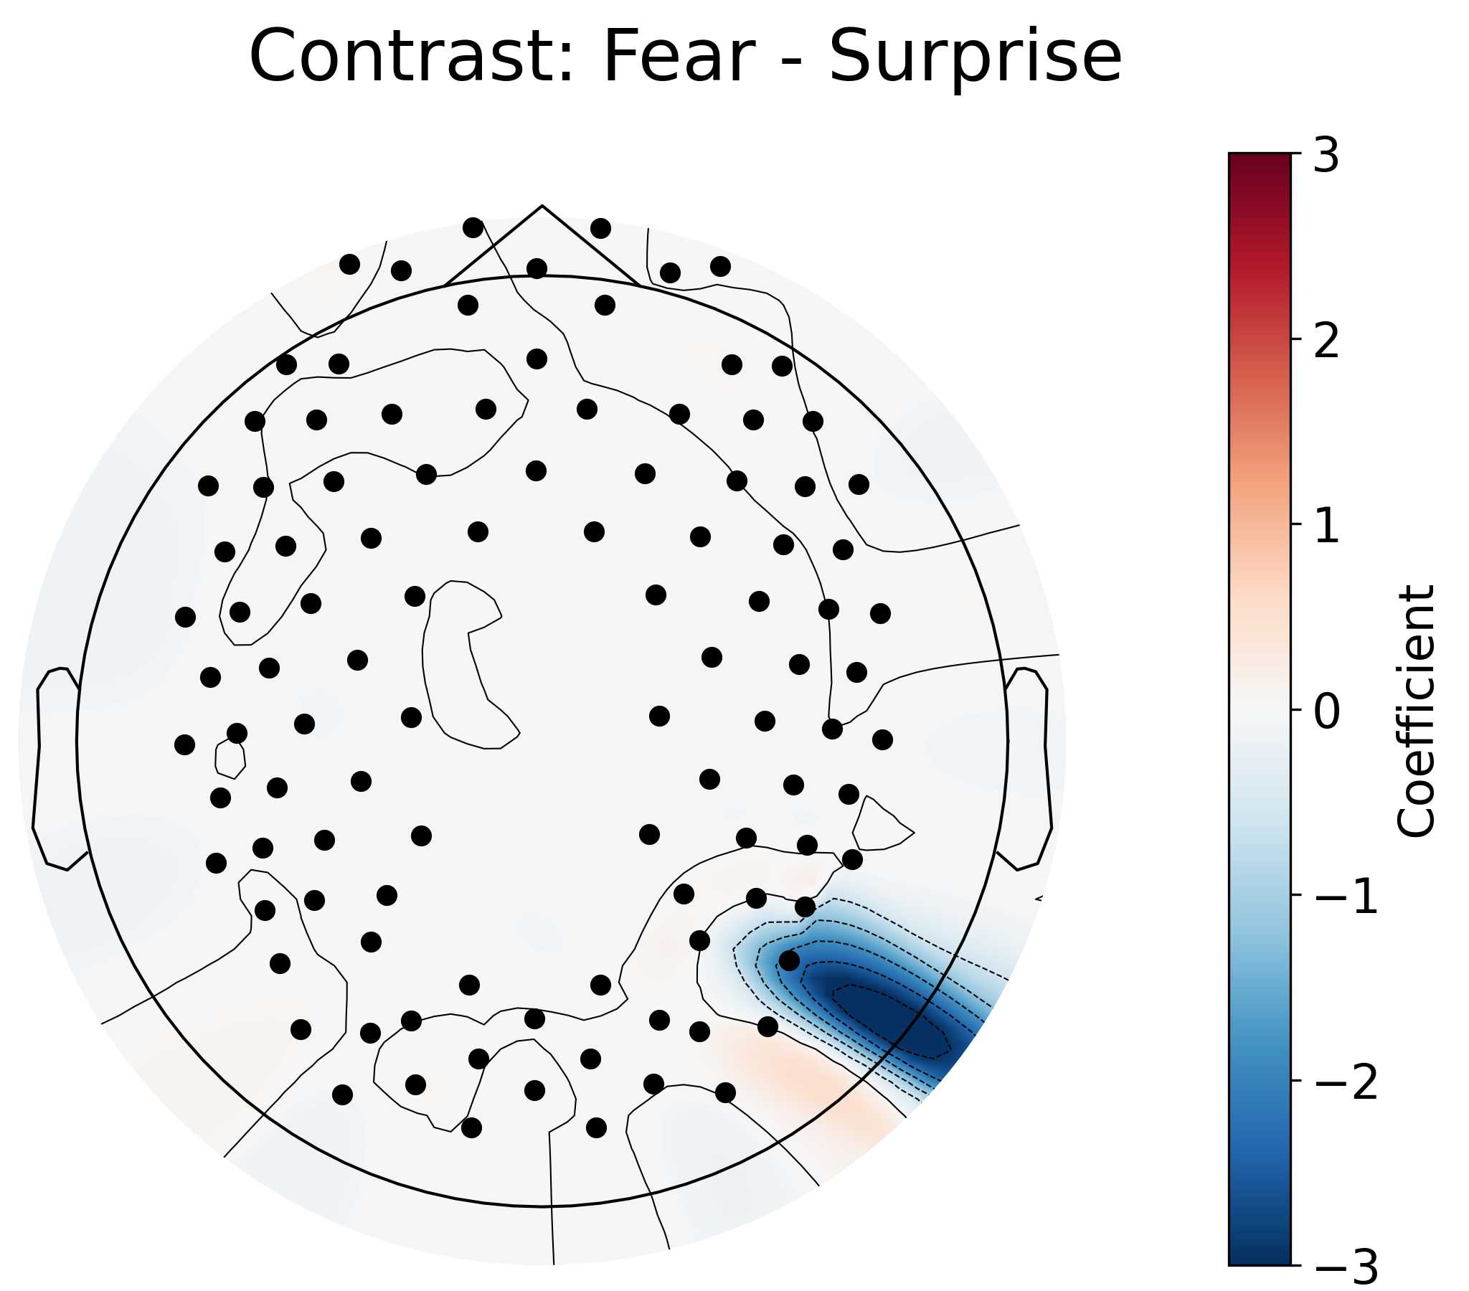
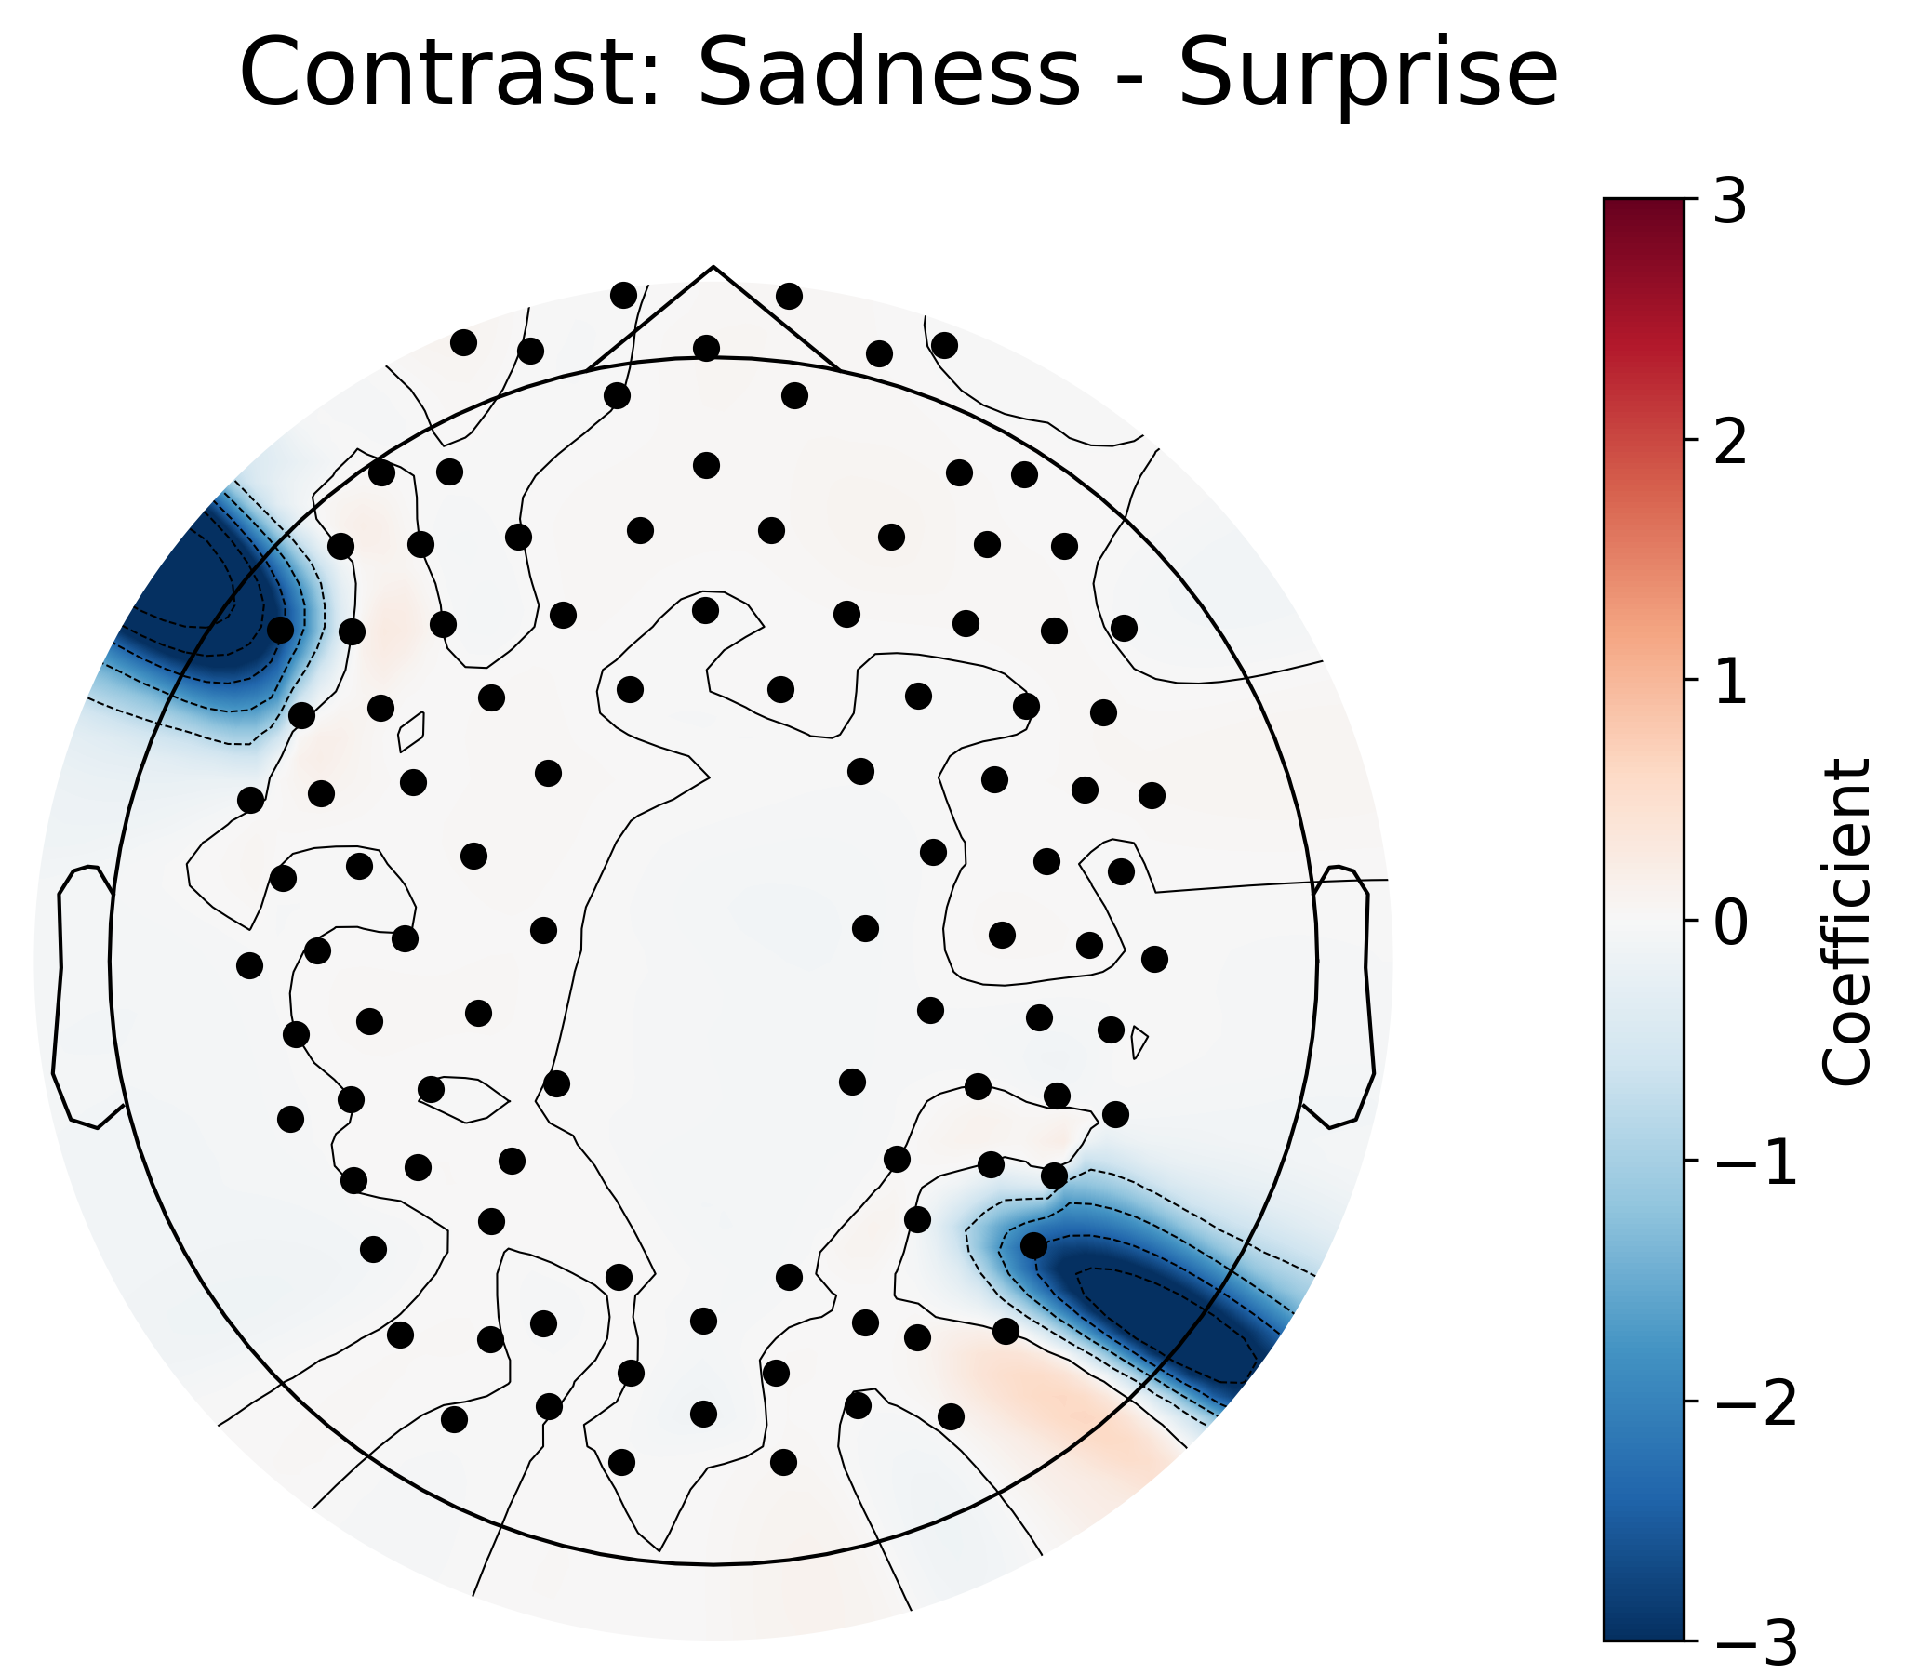
Results: Emotional Faces Surprise Vs. All Other Emotions
Surprisingly, the GLM contrast for Surprise vs. all other emotions shows differences in activation in multiple regions. (except Anger)
No other pairs of emotions showed significant differences.
Notes:
Surprisingly, (pun intended) Surprise vs. all other emotions shows differences in activation in multiple regions as well, except for anger.
I'd like to note that these contrasts were run between all combinations of emotions, but only Surprise and Neutral showed significant differences, there were no other pairs of emotions (i.e. Joy-Sadness, Fear-Anger) that showed significant differences.

Slide 17
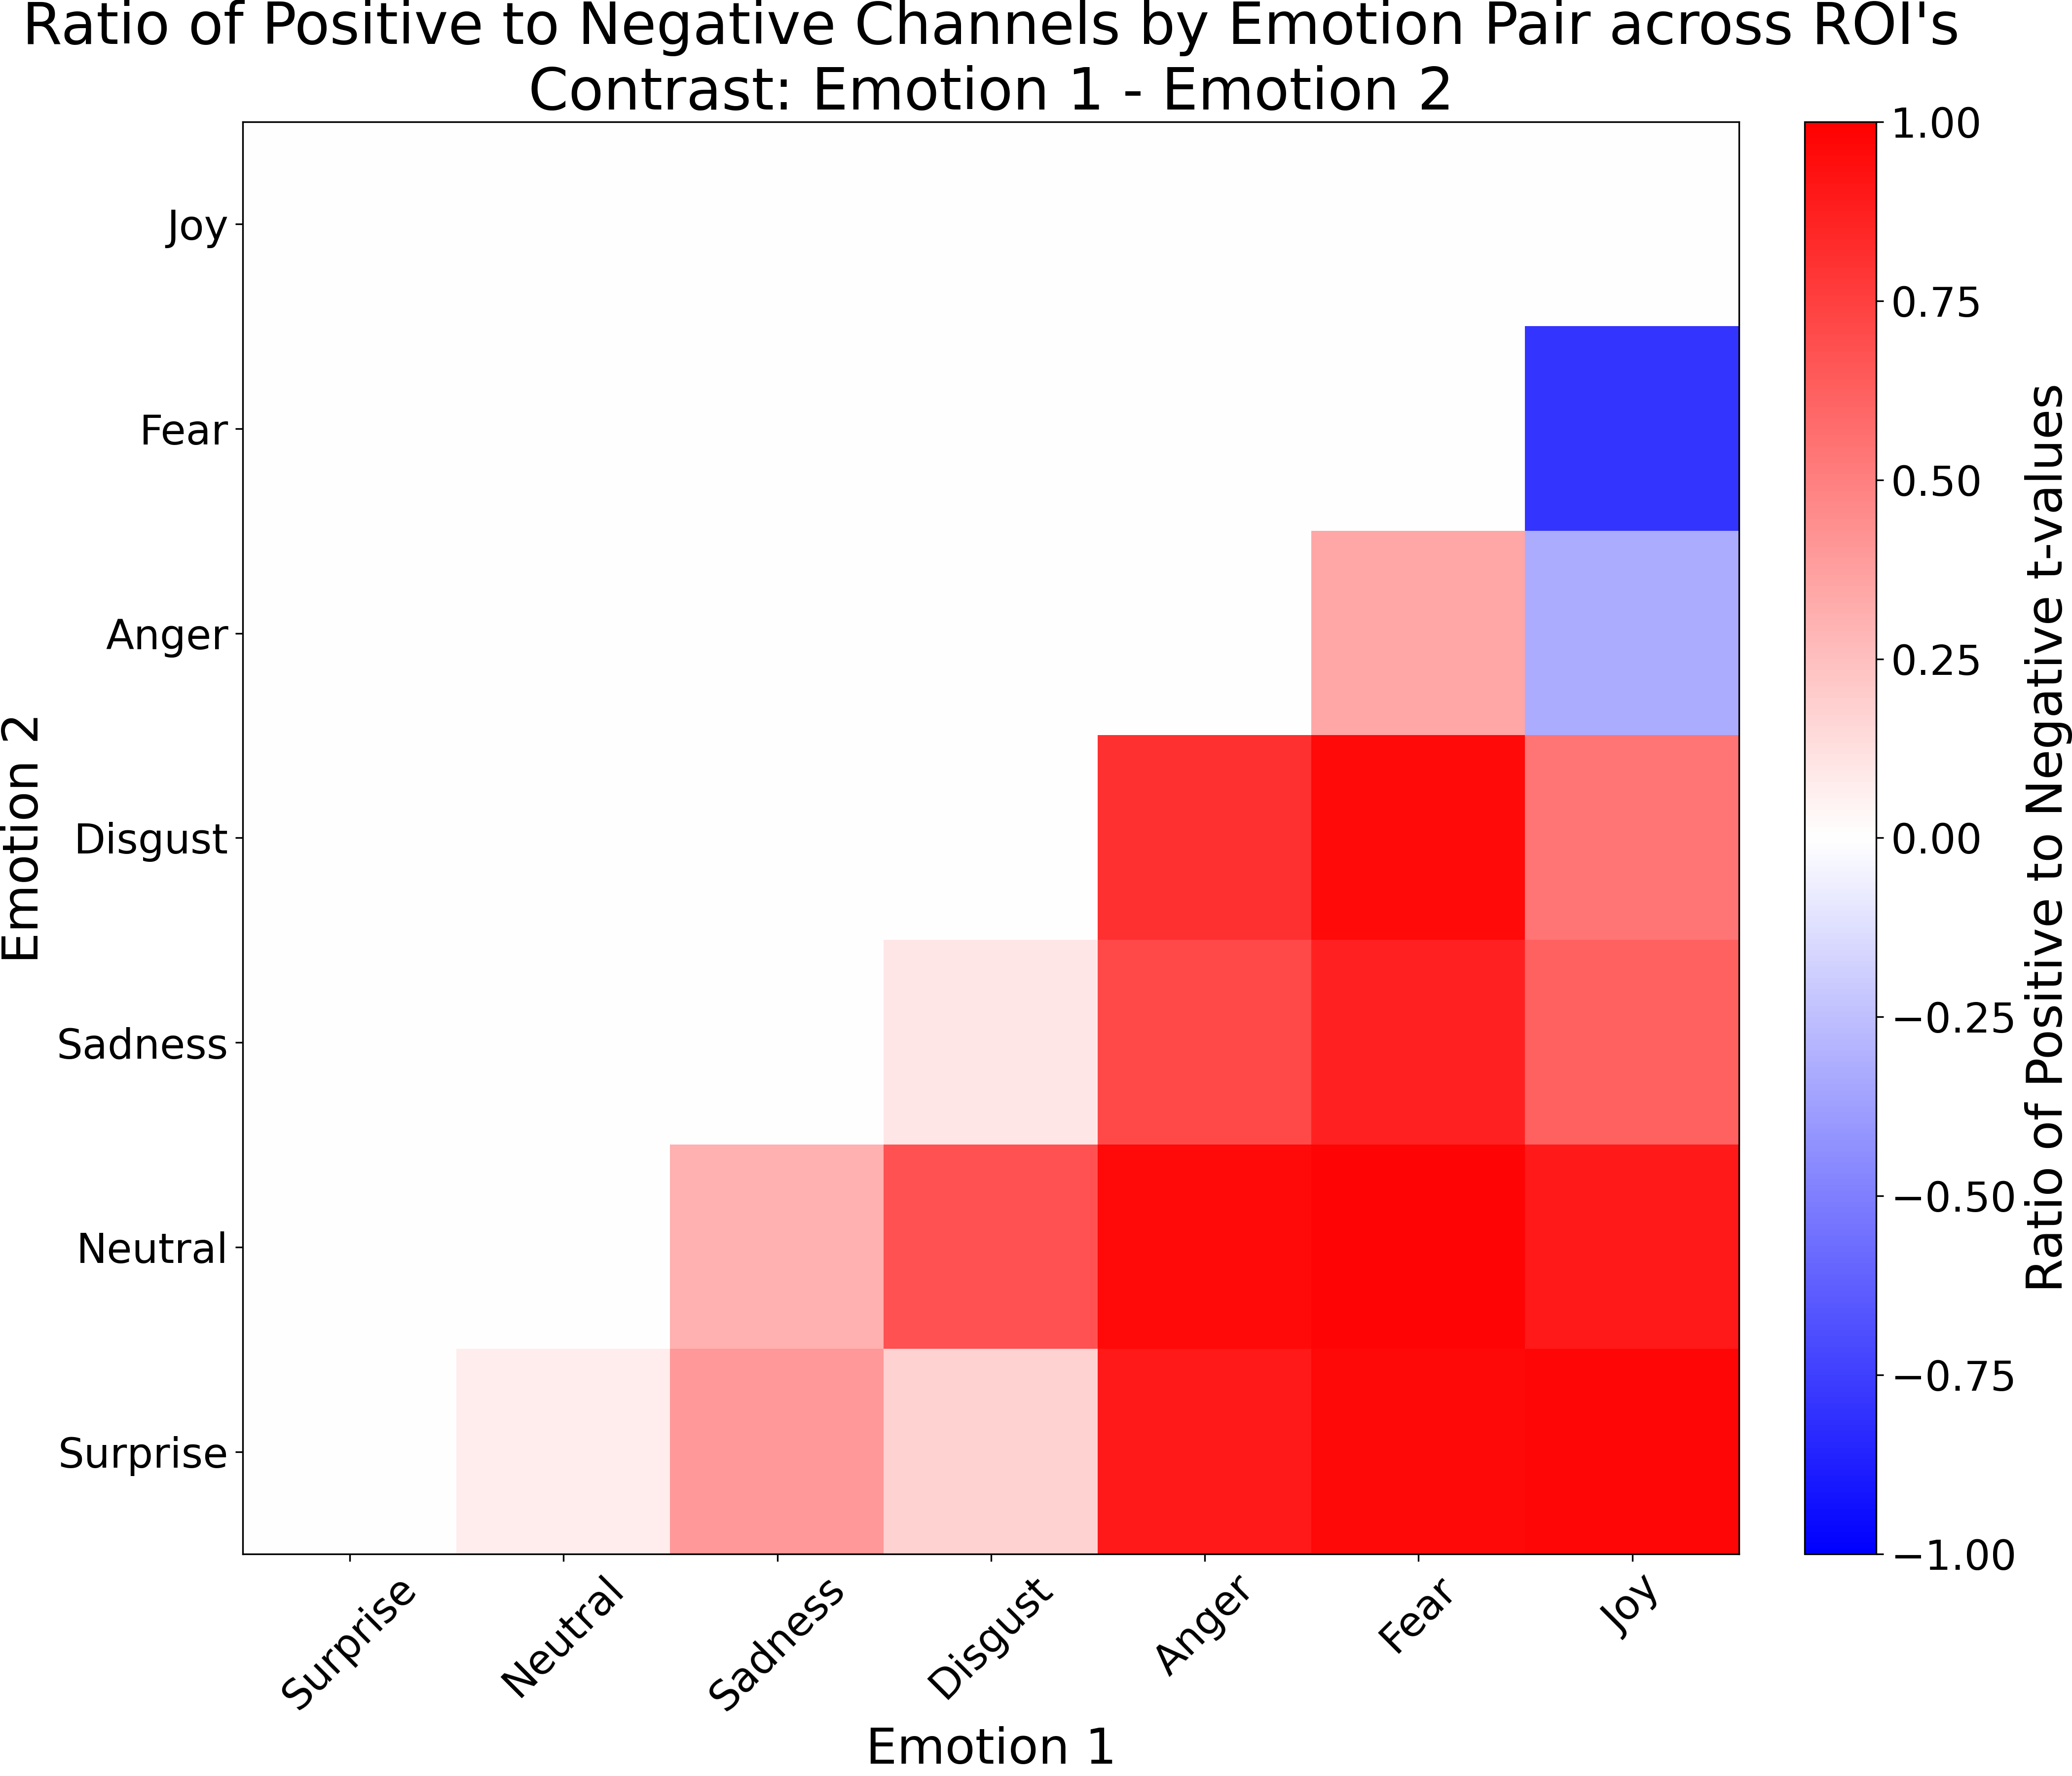
Results: Emotional Faces
We calculated a net connectivity ratio by subtracting the number of significantly negative t-value connections from the positive ones, then dividing by the total number of significant connections.
This ratio indicates which emotion shows stronger overall connectivity across brain regions.
Red means Emotion 1, on the x-axis, has stronger connectivity than Emotion 2, on the y-axis, and vice versa for blue.
Two clusters: Anger, Fear, and Joy have stronger connectivity than Surprise, Neutral, Sadness, and Disgust.
Notes:
So, we've seen the difference in activation in emotions, but we also wanted to look at the differences in connectivity for the emotional faces, this is a bit more of a complex story but there's some exciting results here.
So here we have the Ratio of Positive to Negative Channels by Emotion Pair, across all Regions of Interest.
Red means Emotion 1, on the x-axis, has stronger connectivity than Emotion 2, on the y-axis, and vice versa for blue.
We can see two clusters here, one where Anger, Fear, and Joy have much stronger connectivity, then Surprise, Neutral, Sadness, and Disgust, which seem to have weaker connectivity.

Slide 18
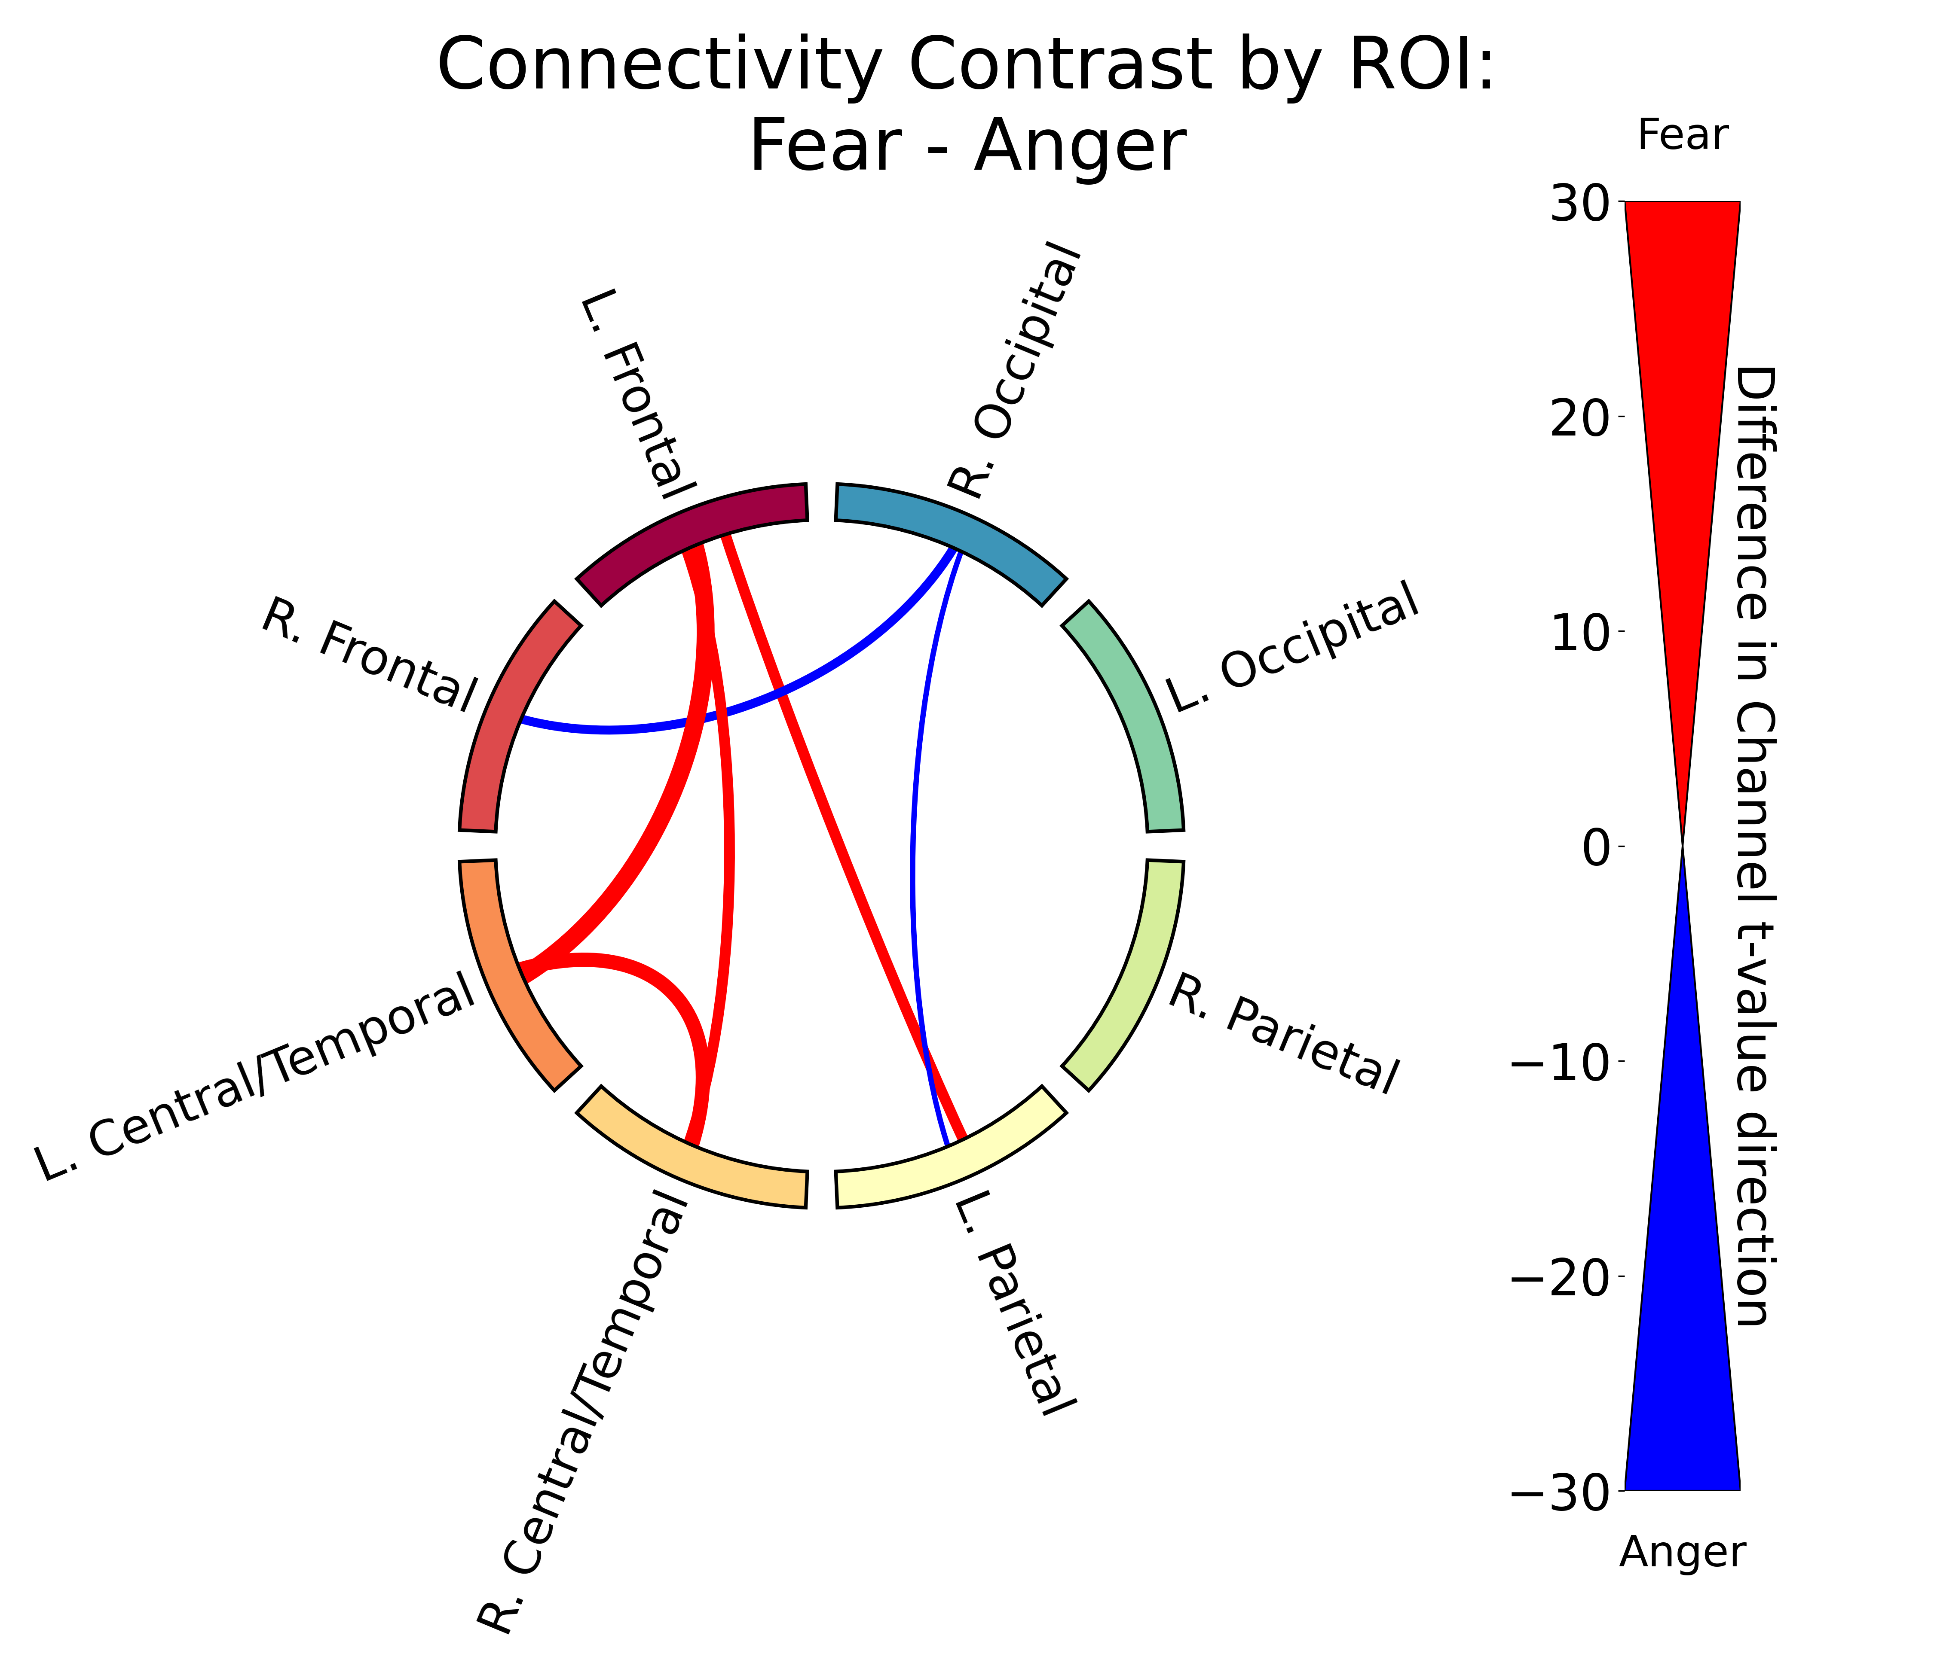
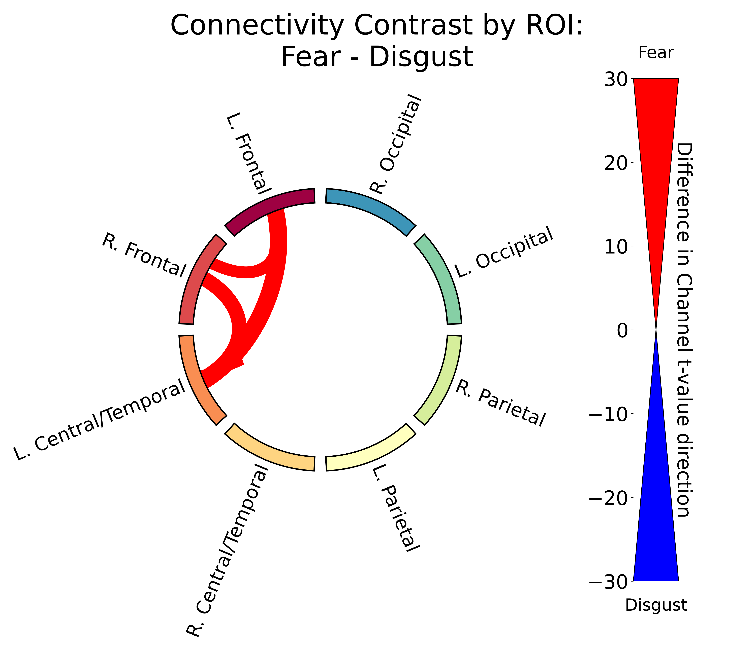
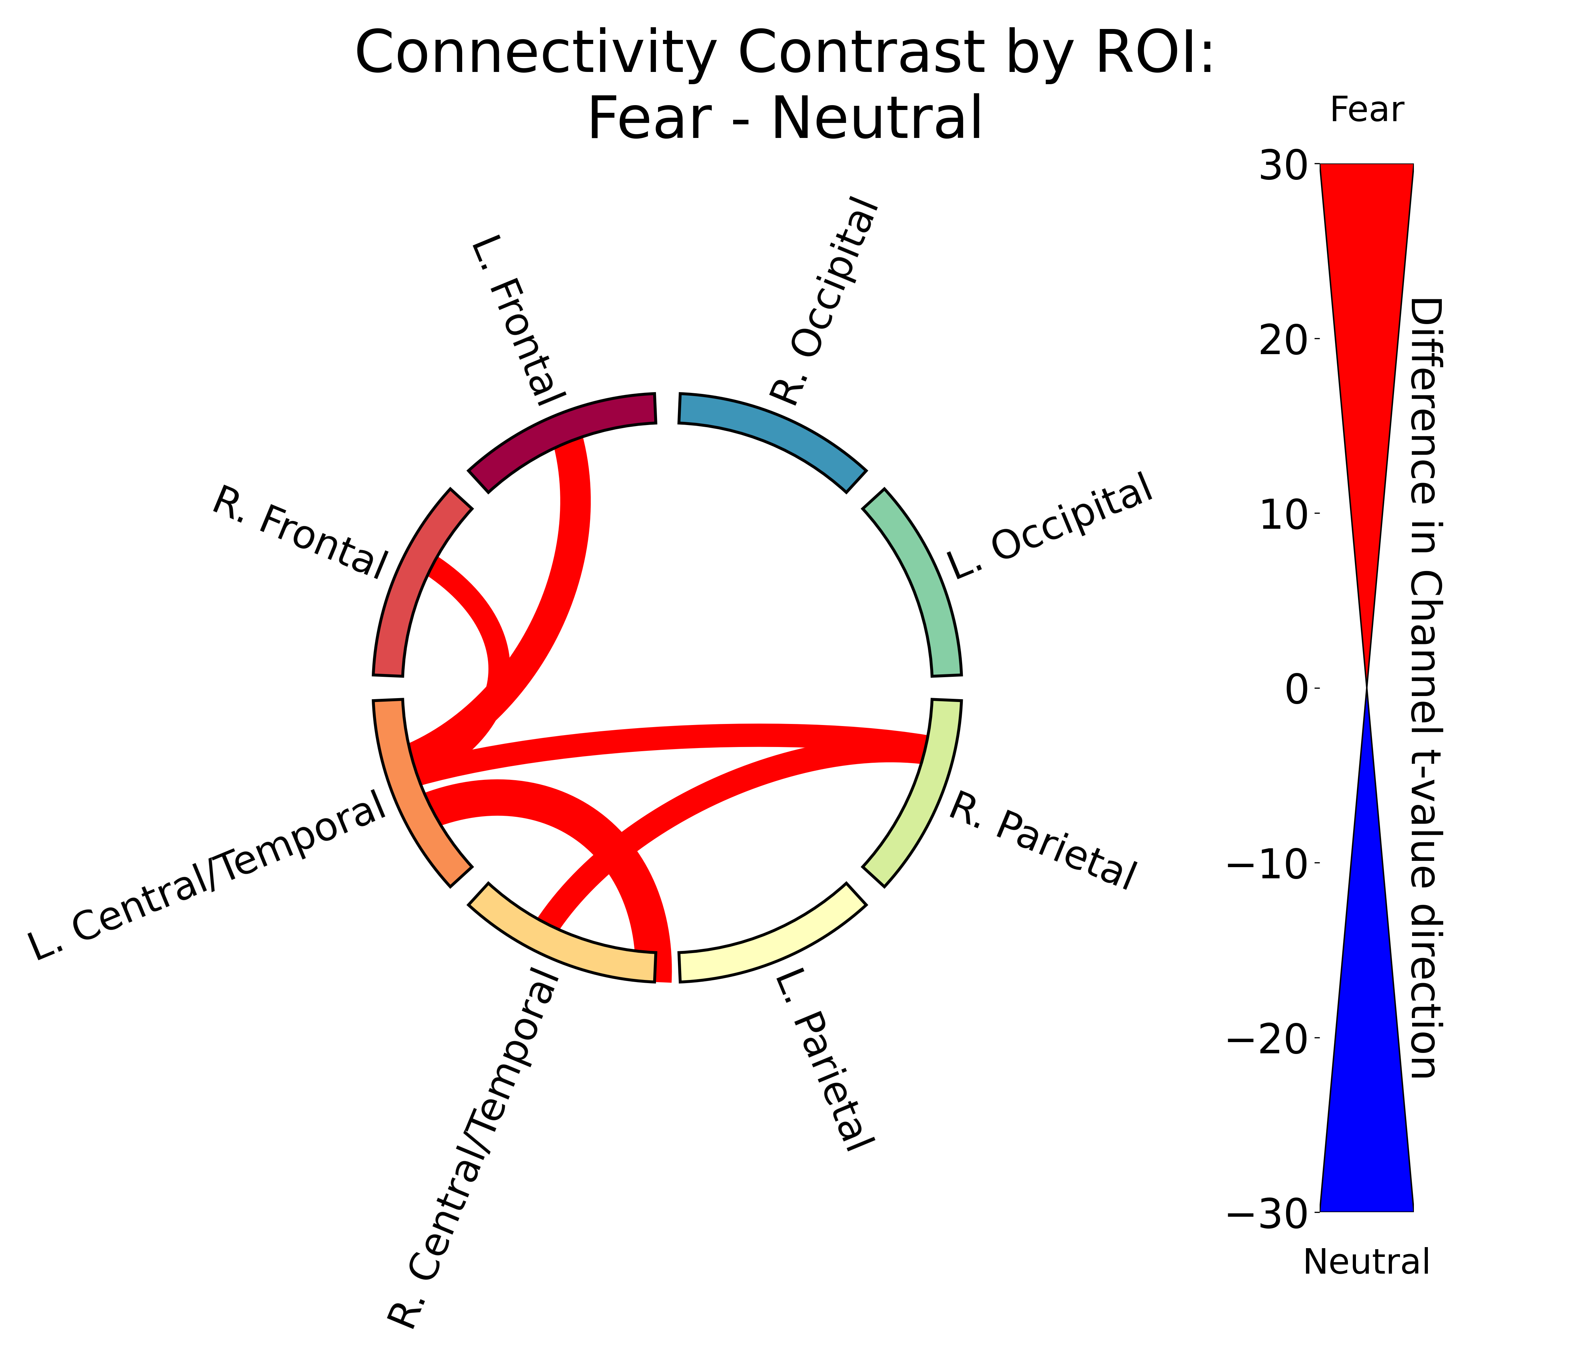
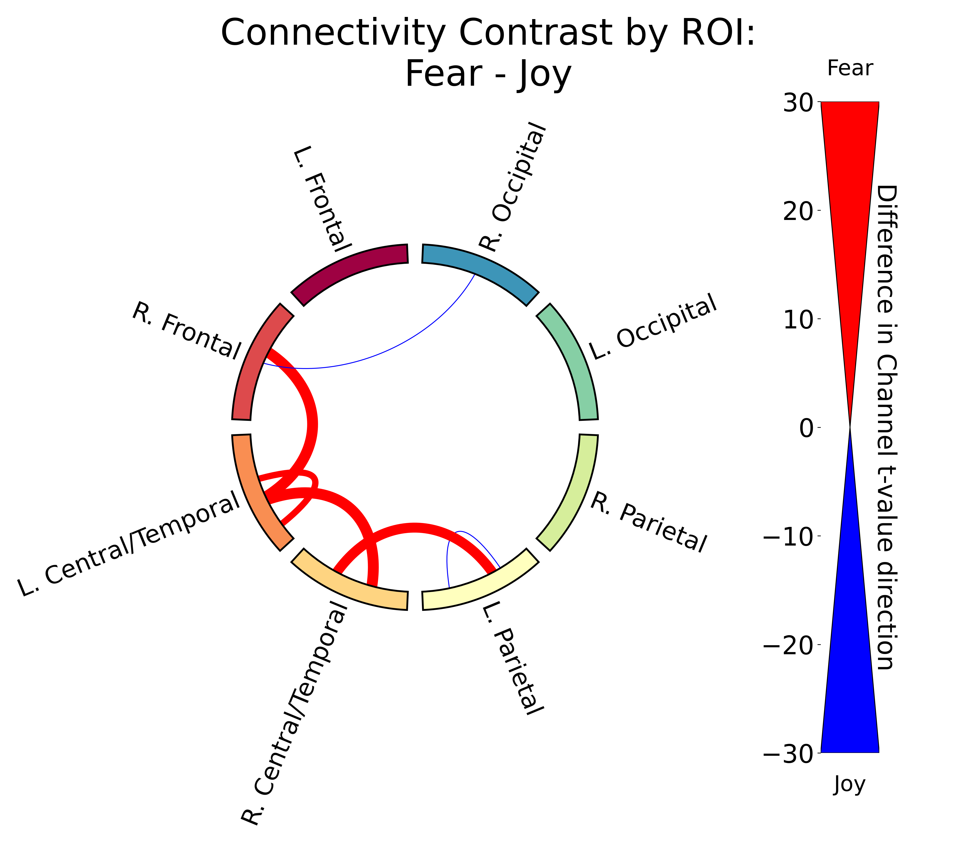
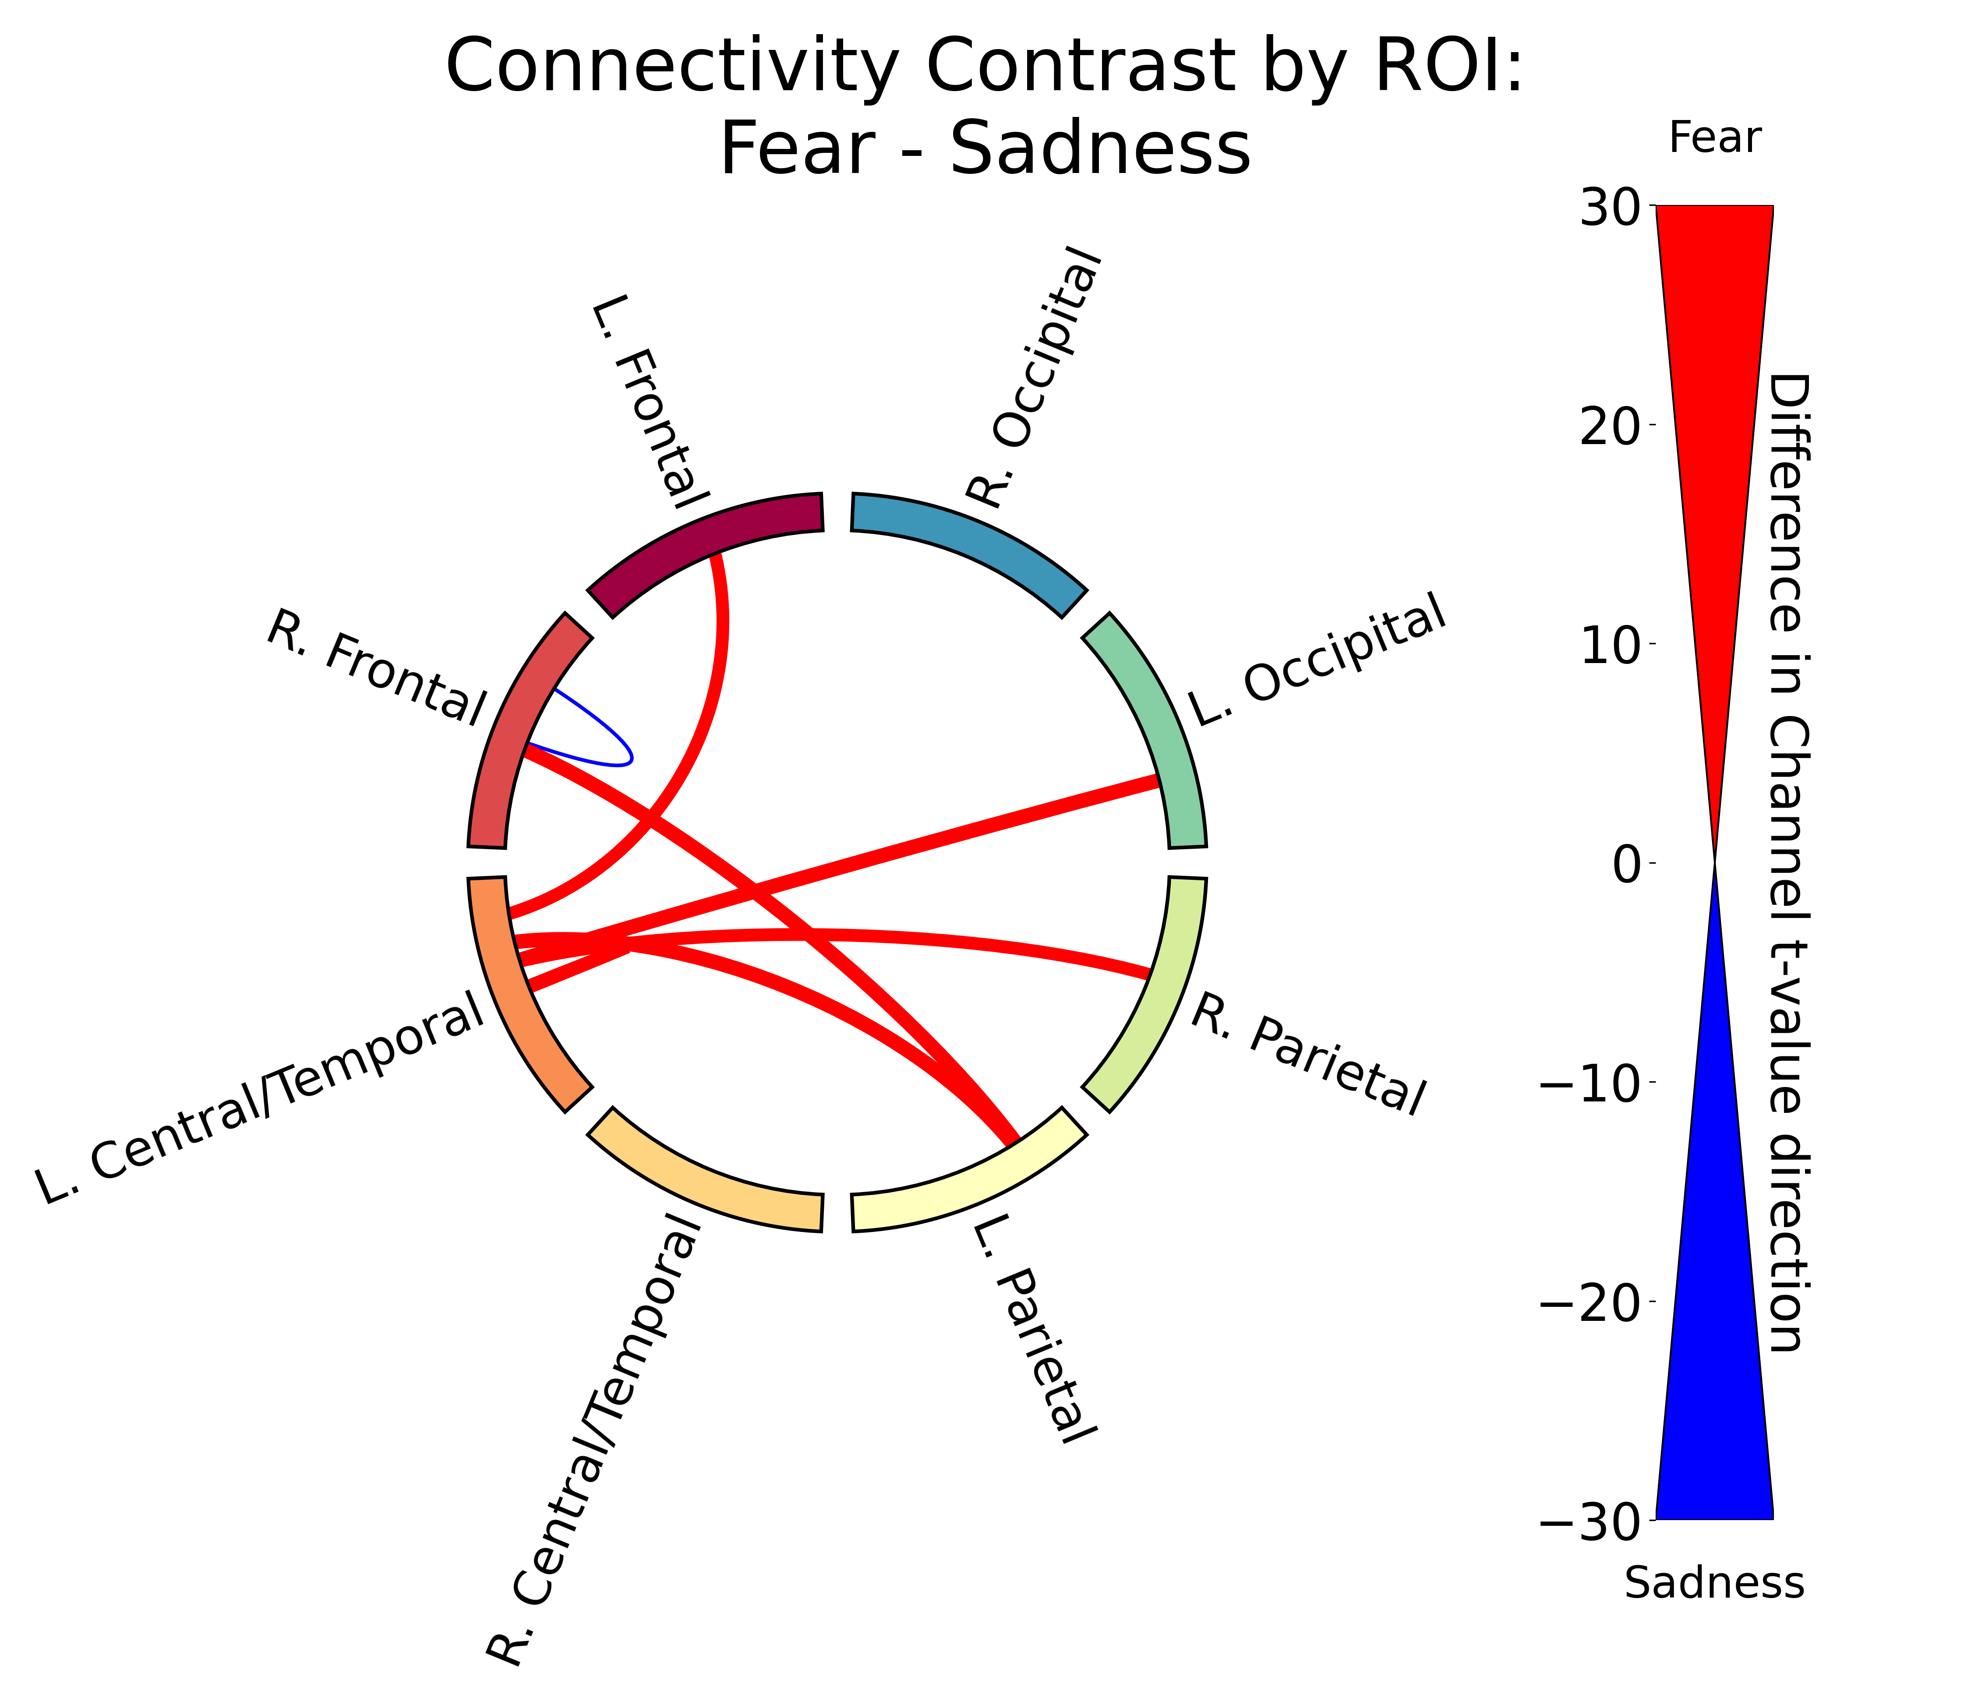
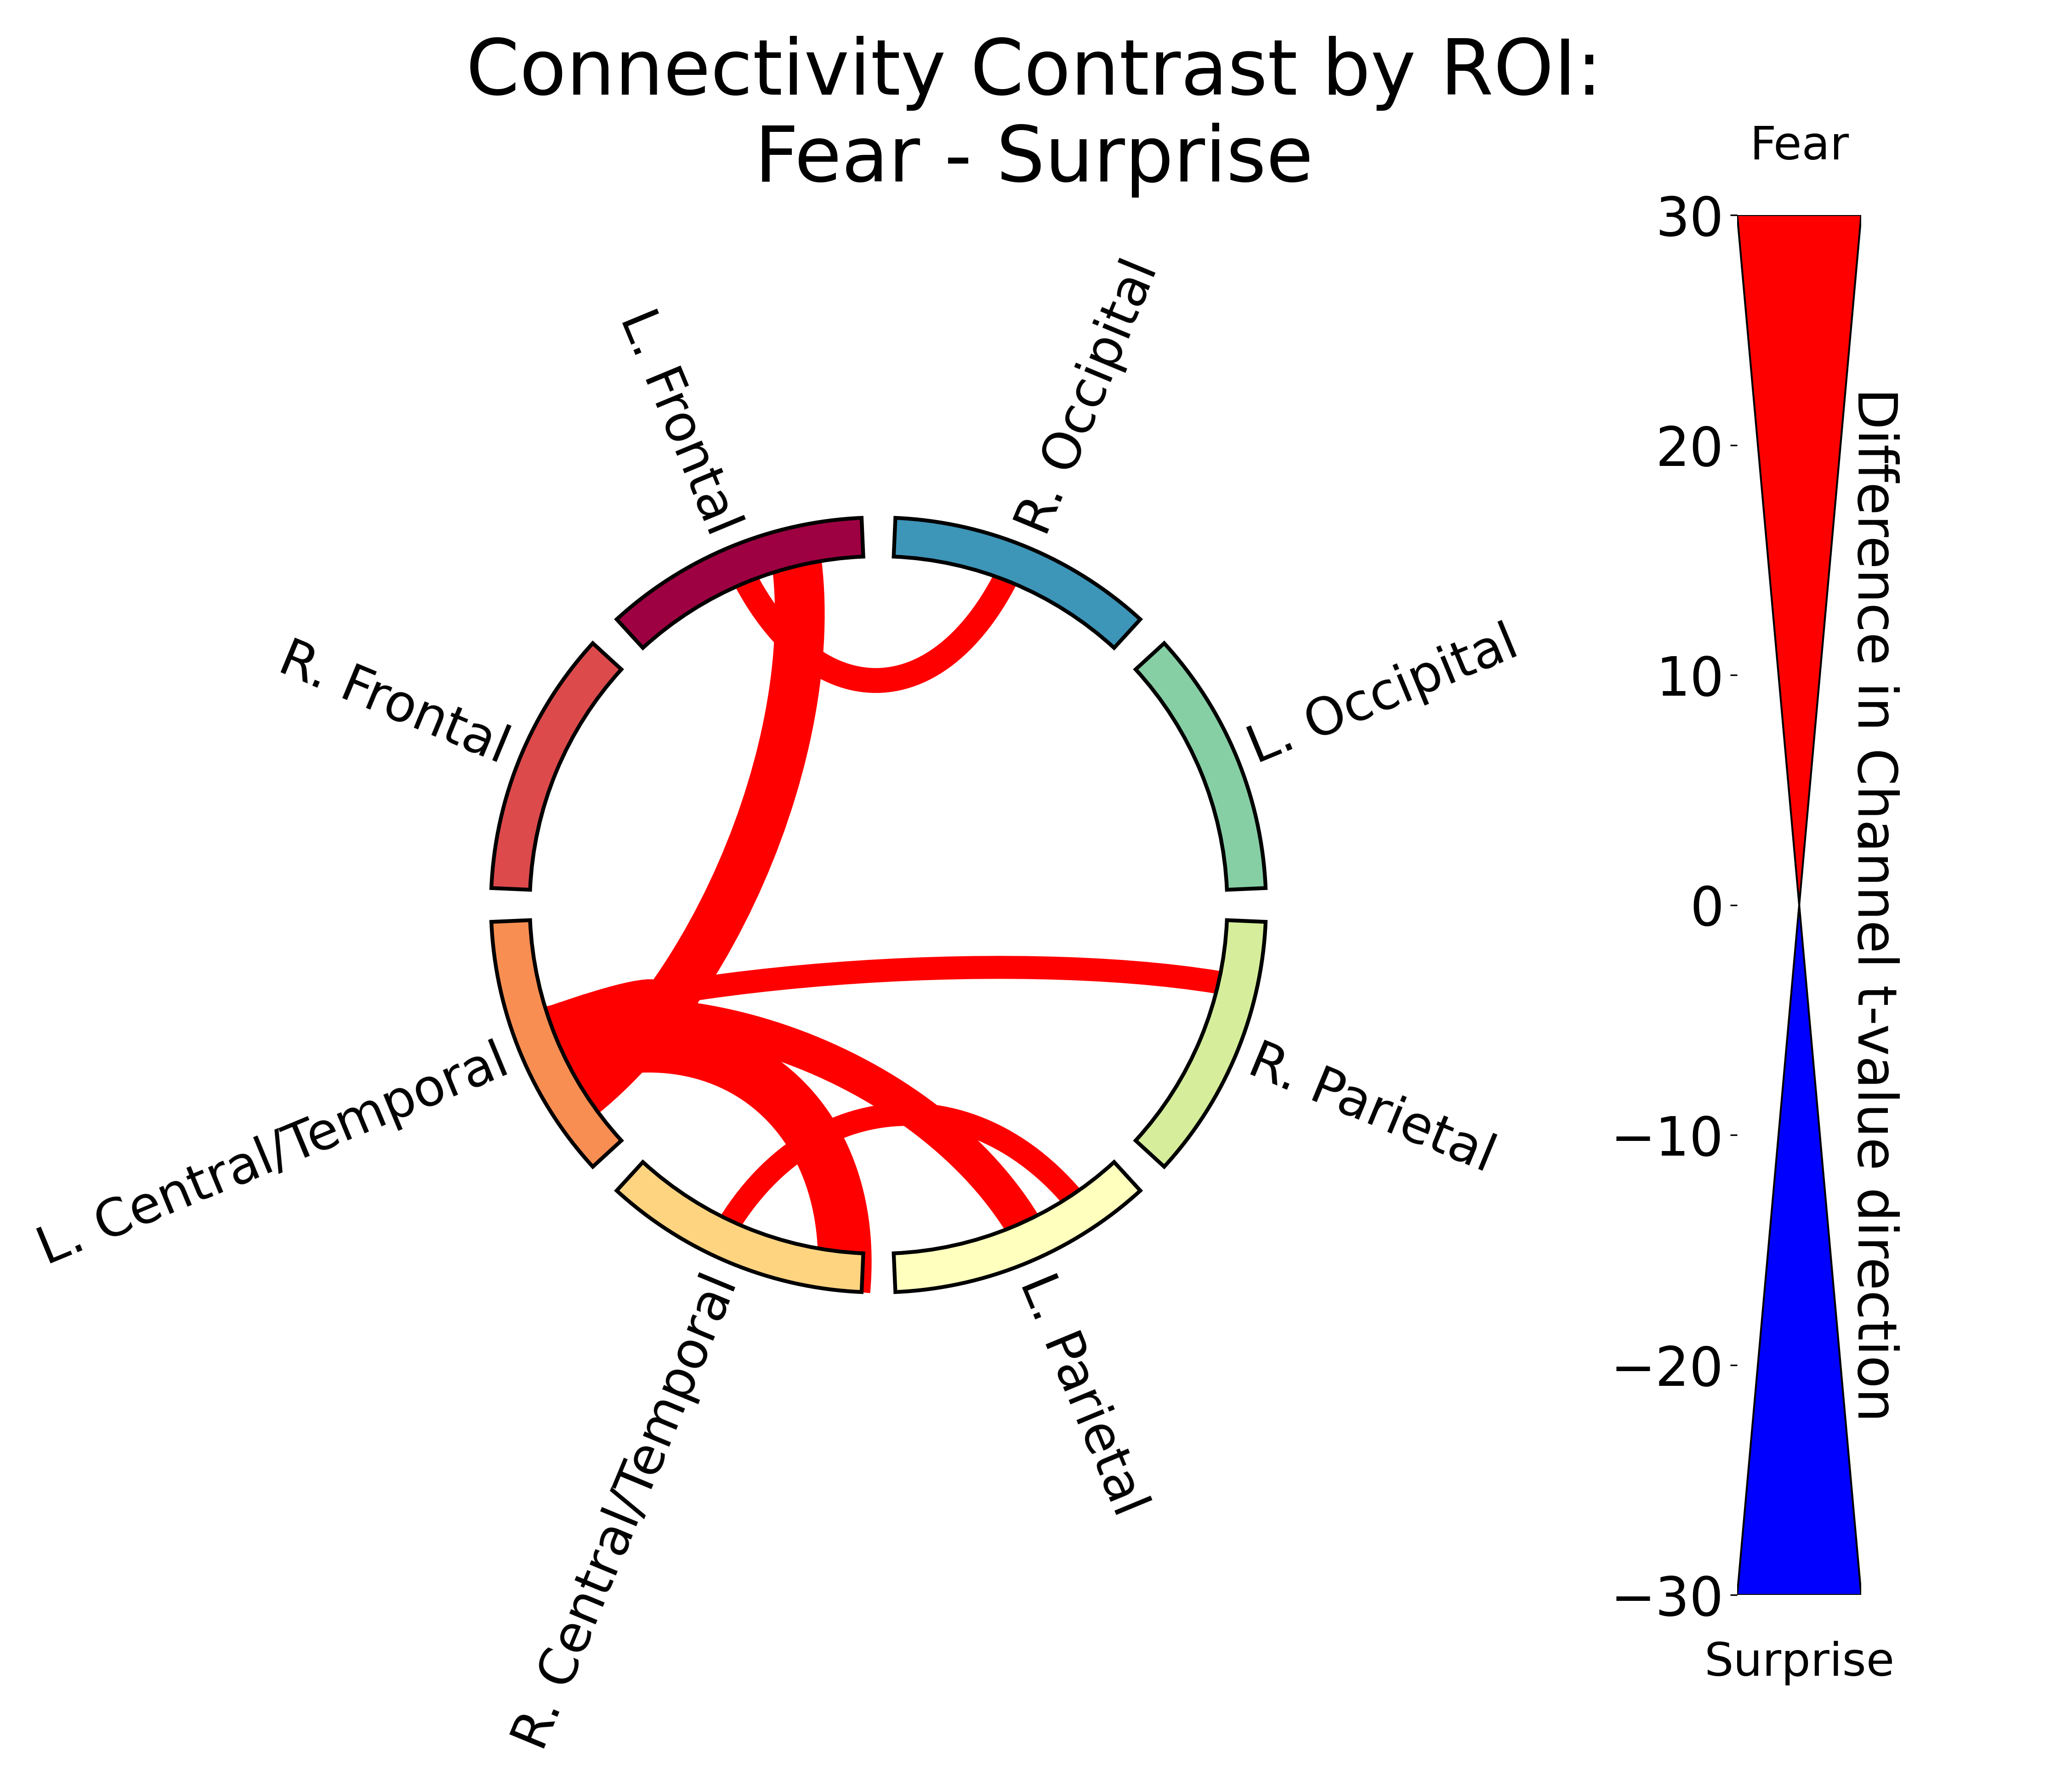
Results: Emotional Faces Fear Vs. All Other Emotions
Difference in connectivity for Fear vs. all other emotions.
We see stronger connectivity for Fear compared to all other emotions.
Notes:
Here we have the differences in connectivity for Fear vs. all other emotions.
Like before, the thick red lines indicate stronger connectivity for Fear between those two regions.
We see that Fear has stronger connectivity compared to all the emotions, lining up with the heatmap in the last slide.

Slide 19
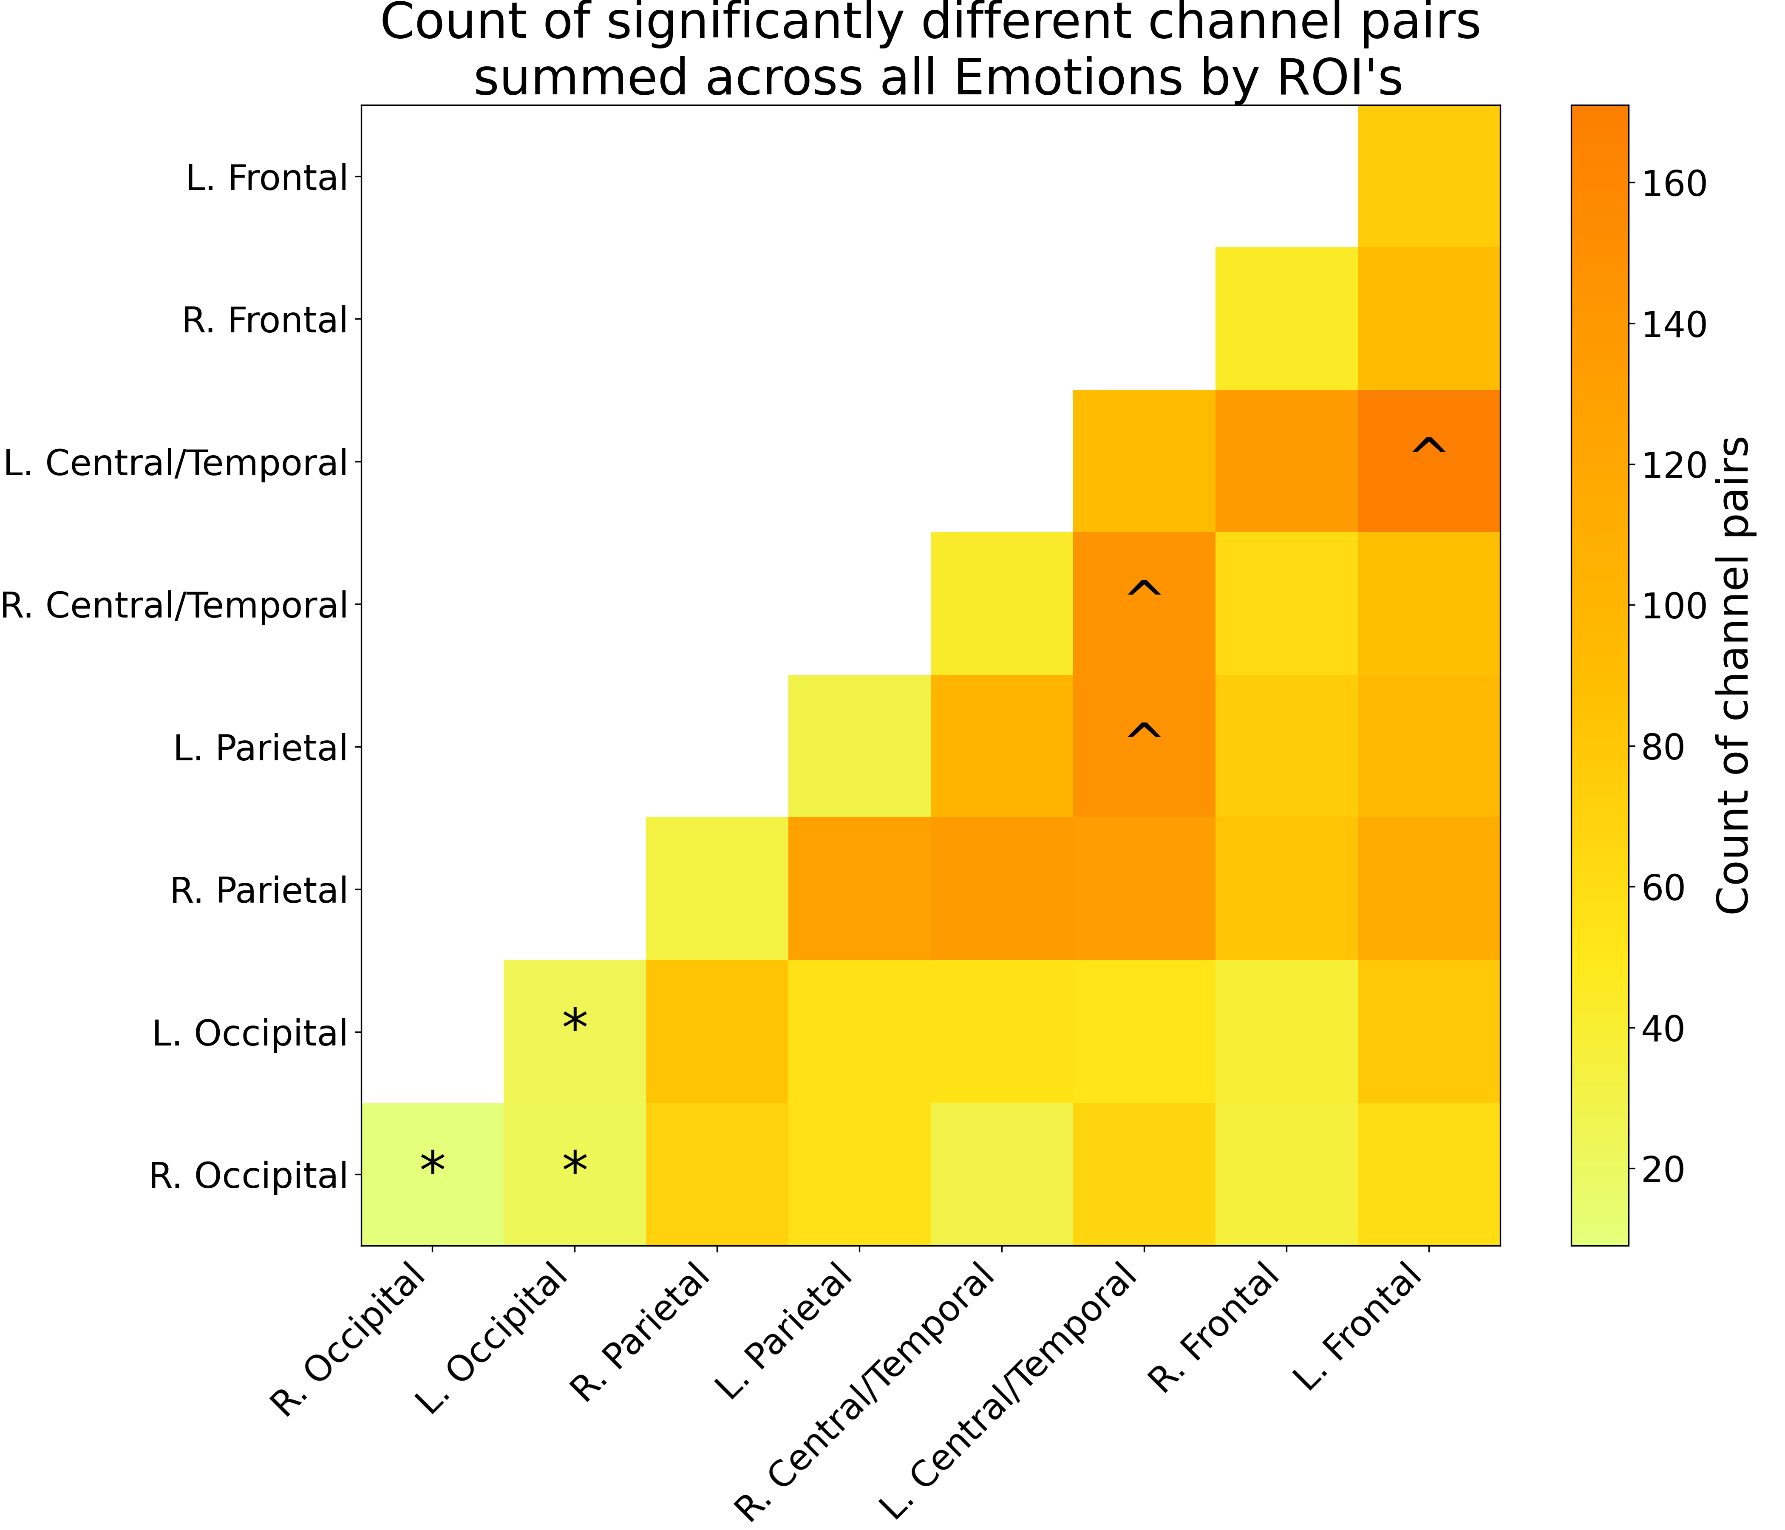
Results: Emotional Faces
Count of significantly different channel pairs by region.
The 3 regions with the greatest and least number of significant channels were marked with carets/asterisks, respectively.
Central/temporal and parietal regions are more variable in their connectivity patterns across emotions.
Connectivity patterns in occipital regions were more similar across emotions.
Notes:
Here, we generated a count of the number of statistically significant channels per region that differed across emotion.
I marked the 3 regions with the greatest and least number of significant channels with carets/asterisks, respectively.
The central/temporal and parietal regions produced the greatest number of significant connections, which suggests that these regions are more variable in their connectivity patterns across emotions.
In contrast, the occipital regions produced the fewest number of significant connections, which suggests that the connectivity patterns between these regions are similar across emotions.

Slide 20
Discussion: Real Vs. Virtual Faces
Neural Activation (GLM):
Virtual faces elicited stronger left occipital activation than real faces.
Virtual faces are harder to recognize/require more effort to recognize.
Functional Connectivity:
Real faces evoked significantly greater connectivity across the brain, particularly between:
Left/right parietal and left frontal regions
Left/right central/temporal regions
Real faces activate a wider and more connected brain network than virtual faces, as there was stronger connectivity between higher-order socio-cognitive regions.
Notes:
So what did we learn from these results?
First, from our GLM analysis, we found that virtual faces elicited stronger activation in the left occipital region compared to real faces.
This likely reflects the greater visual processing effort required to recognize virtual faces, which tend to be less familiar or less detailed than real ones, in our case.
In contrast, our functional connectivity results showed that real faces evoked significantly stronger connections across the brain, especially between the left and right parietal regions and the left frontal region, as well as between the left and right central and temporal regions.
This indicates that real face recognition engages a wider and more connected brain network, with stronger connectivity between higher-order socio-cognitive regions.
These findings suggest that while virtual faces are perceived as faces, they do not recruit the same neural mechanisms as real ones, supporting our first hypothesis.

Slide 21
Discussion: Emotional Faces
Neural Activation (GLM):
Neutral showed more activation than the other emotions (except Disgust), in mainly occipital/parietal regions.
Surprise showed more activation than the other emotions (except Anger), in mainly left central/temporal and right parietal regions.
Processing more salient emotions may not result in greater activation.
Functional Connectivity:
Fear evoked the strongest connectivity, especially from left central/temporal regions.
Fear, Anger, and Joy had much stronger connectivity than the other emotions.
Emotional expressions are processed by distributed brain networks, with occipital regions handling initial face processing and parietal and central/temporal areas decoding emotional expressions.
Notes:
For emotion, from the GLM results, we found that neutral faces triggered more activity than most of the emotional expressions, particularly in occipital and parietal regions, suggesting enhanced visual processing.
Surprise also showed relatively strong activation, especially in left central and temporal areas, as well as the right parietal cortex.
Interestingly, this suggests that more emotionally intense or salient expressions don't necessarily lead to stronger brain activation.
On the connectivity side, fear stood out, it evoked the strongest connectivity, particularly from the left central and temporal regions.
As well, Fear, anger, and joy was grouped as a cluster of emotions that all showed much higher connectivity than the other emotions.
These findings support the idea that emotional expressions are not processed in isolated brain regions, but through distributed networks, and that while occipital areas are crucial for initial face processing, the emotional nuances of faces are primarily decoded in more distributed networks involving parietal and central/temporal regions, regardless of the emotion presented.

Slide 22
Conclusion
Implications:
Offers insight into how the brain responds to virtual stimuli, relevant for Virtual Reality (VR), Brain Computer Interfaces (BCI).
Can inform the design of more realistic and effective virtual characters in education and/or gaming.
Future Research:
Future research could explore how these neural differences influence real-world behaviors, or how they affect interactions in digital environments.
Notes:
So in conclusion, this research offers insight into how the brain responds to virtual stimuli, which is relevant for applications in Virtual Reality (VR) like gaming or education.
As well as Brain Computer Interfaces (BCI), for example you can imagine having an fNIRS cap on and using it to control a computer or a virtual character in a game.
This research can inform the design of more realistic and effective virtual characters in education and/or gaming, which can help improve the user experience.
Finally, future research could explore how these neural differences influence real-world behaviors, or how they affect interactions in digital environments.
For example, we could look at how people react to virtual faces in video games, or how students might learn things differently when interacting with virtual teachers or avatars.
Thank you for your time and attention.

Slide 23
References
[1] Aline W. De Borst and Beatrice De Gelder. Is it the real deal? Perception of virtual characters versus humans: an affective cognitive neuroscience perspective. Frontiers in Psychology, 6, May 2015. ISSN 1664-1078. doi:10.3389/fpsyg.2015.00576. URL http://www.frontiersin.org/Cognitive_Science/10.3389/fpsyg.2015.00576/abstract.
[2] Hiroto Kawasaki, Naotsugu Tsuchiya, Christopher K. Kovach, Kirill V. Nourski, Hiroyuki Oya, Matthew A. Howard, and Ralph Adolphs. Processing of Facial Emotion in the Human Fusiform Gyrus. Journal of cognitive neuroscience, 24(6):1358–1370, June 2012. ISSN 0898-929X.doi: 10.1162/jocn a 00175. URL https://www.ncbi.nlm.nih.gov/pmc/articles/PMC3566877/
[3] Kristen A. Lindquist, Tor D. Wager, Hedy Kober, Eliza Bliss-Moreau, and Lisa Feldman Barrett. The brain basis of emotion: A meta-analytic review. Behavioral and Brain Sciences, 35(3):121–143, June 2012. ISSN1469-1825, 0140-525X. doi: 10.1017/S0140525X11000446. URL https://www.cambridge.org/core/journals/behavioral-and-brain-sciences/article/brain-basis-of-emotion-a-metaanalytic-review/80F95F093305C76BA2C66BBA48D4BC8A.
[4] Wataru Sato, Sakiko Yoshikawa, Takanori Kochiyama, and Michikazu Matsumura. The amygdala processes the emotional significance of facial expressions: an fMRI investigation using the interaction between expression and face direction. NeuroImage, 22(2):1006–1013, June 2004. ISSN1053-8119. doi: 10.1016/j.neuroimage.2004.02.030. URL https://www.sciencedirect.com/science/article/pii/S1053811904001235.

